Slide 1
Announcements
AAPT Physics Bowl 1st and 2nd Thursday
Ch 28-29 HW Quiz and HW due Friday
Mechanics MC Packet due Monday 4/11
Mechanics FR Packet due Monday 4/18
LR Circuit Derivation Quiz Friday 4/22
Mechanics Mock AP 4/26-27
Magnetism Exam (Ch 30 HW due) 4/28-29
E&M Mock various days 5/3-5
AP Exam (Finals) 5/9

Slide 2
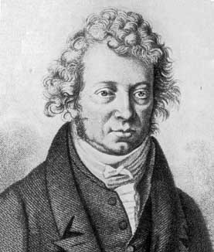
Ampere’s Law

Slide 3
College Board Objectives

Slide 4
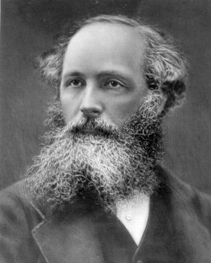
Why do we need Ampere’s Law?
Biot-Savart can be very complicated for some distributions.
Ampere’s Law applies symmetry (similar to Gauss’s Law)
Can be derived from Biot-Savart
Attributed to Andre-Marie Ampere (1775-1836), but was actually developed by James Clerk Maxwell!

Slide 5
Ampere’s Law
Ampere’s Law is used to calculate magnetic fields from current.
The second of four Maxwell equations we’ll learn.
Maxwell Equations:
Gauss’s Law of Electricity
Gauss’s Law of Magnetism
Ampere’s Law
Faraday’s Law of Induction

Slide 6
Ampere’s Law - statement
i
μ_{o}: magnetic permeability of free space (4π x 10⁻⁷ Tm/A)
i: current (Amperes)
B: magnetic field (Tesla)
s: distance around Amperian loop (meters)
Amperian Loop

Slide 7
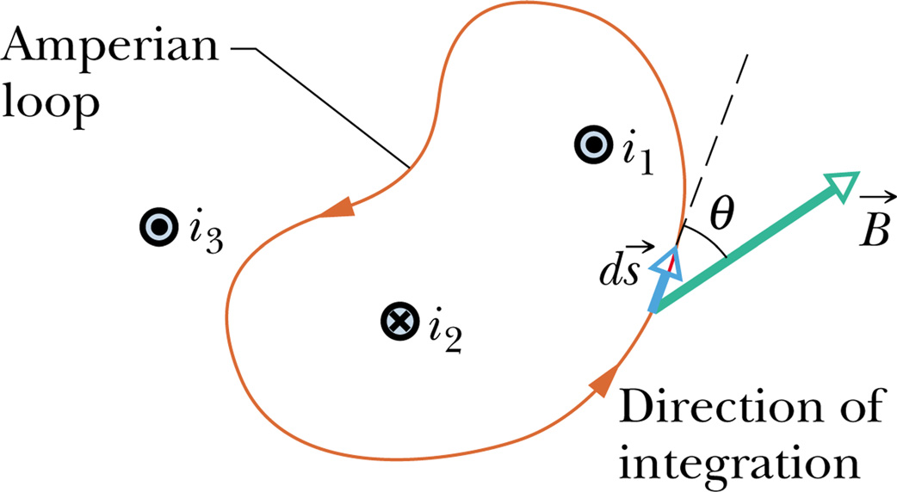
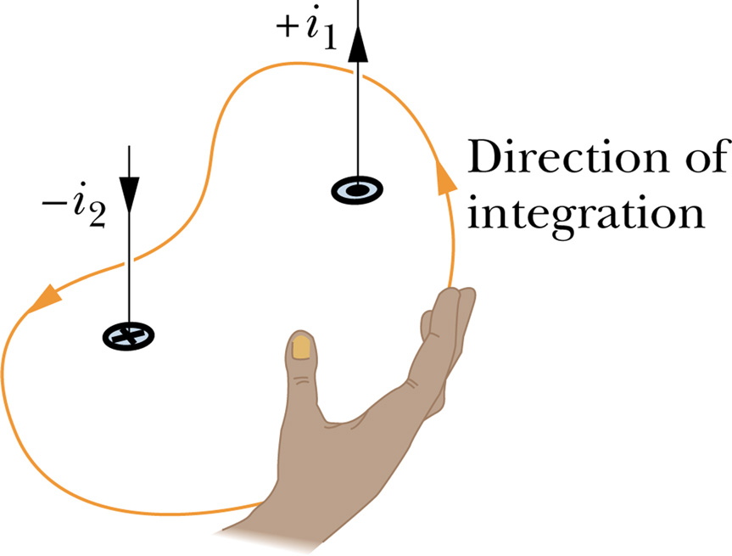

Slide 8
Ampere’s Law
i

Slide 9
Sample Problem: Use Ampere’s Law to derive the magnetic field a distance r from the center of a wire of radius R carrying current I_{o}, where r > R.
I_{o}

Slide 10
Sample Problem: Use Ampere’s Law to derive the magnetic field a distance r from the center of a wire of radius R carrying current I_{o}, where r<R.
I_{o}

Slide 11
Ampere’s Law
B
r
R
R
I_{o}

