Slide 1
ANNOUNCEMENTS:
This week: Labs Mon, Tues, Thus, Fri + Testing + Girls FT + Chem Exam + Assembly Schedule
Next week: Lab Wed, Test + HW due Friday (leaving early?)
Extra Credit? Joseph! This weekend- your name and mine on the back of your ticket.
Optics: Get some colored pencils and a ruler!

Slide 2
Unit II-4: Thermodynamics
Part I: The Atomic Model and Thermal Expansion

Slide 3
Flashbacks!!!!
CHEMISTRY

Slide 4
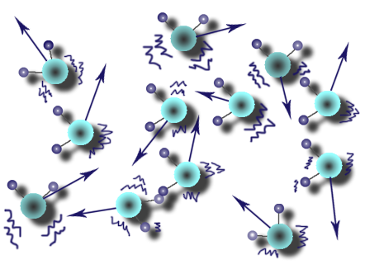
The kinetic Molecular Theory:
All matter is made of very small particles.
Those particles are in constant random motion.
Explains observable, macroscopic properties of matter and energy

Slide 5
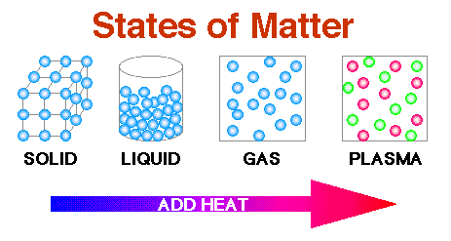
States of matter:
Solid: Definite shape and volume
Liquid: Indefinite shape, but definite volume
Gas: Indefinite shape, indefinite volume
Plasma: Superheated, charged gas

Slide 6
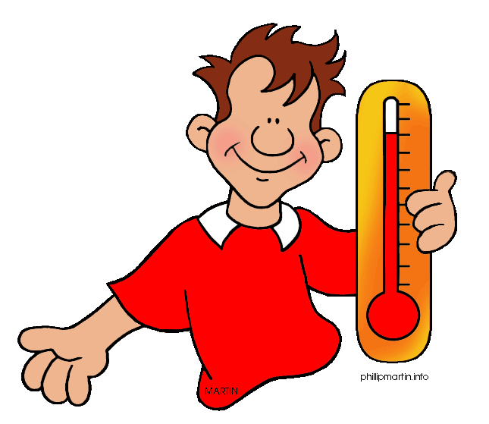
States of matter:
States of matter depend on the energy of the particles.
Temperature:
The average kinetic energy of particles
In Celcius or Kelvin for science
Heat: not the same as temperature! More on that later….

Slide 7
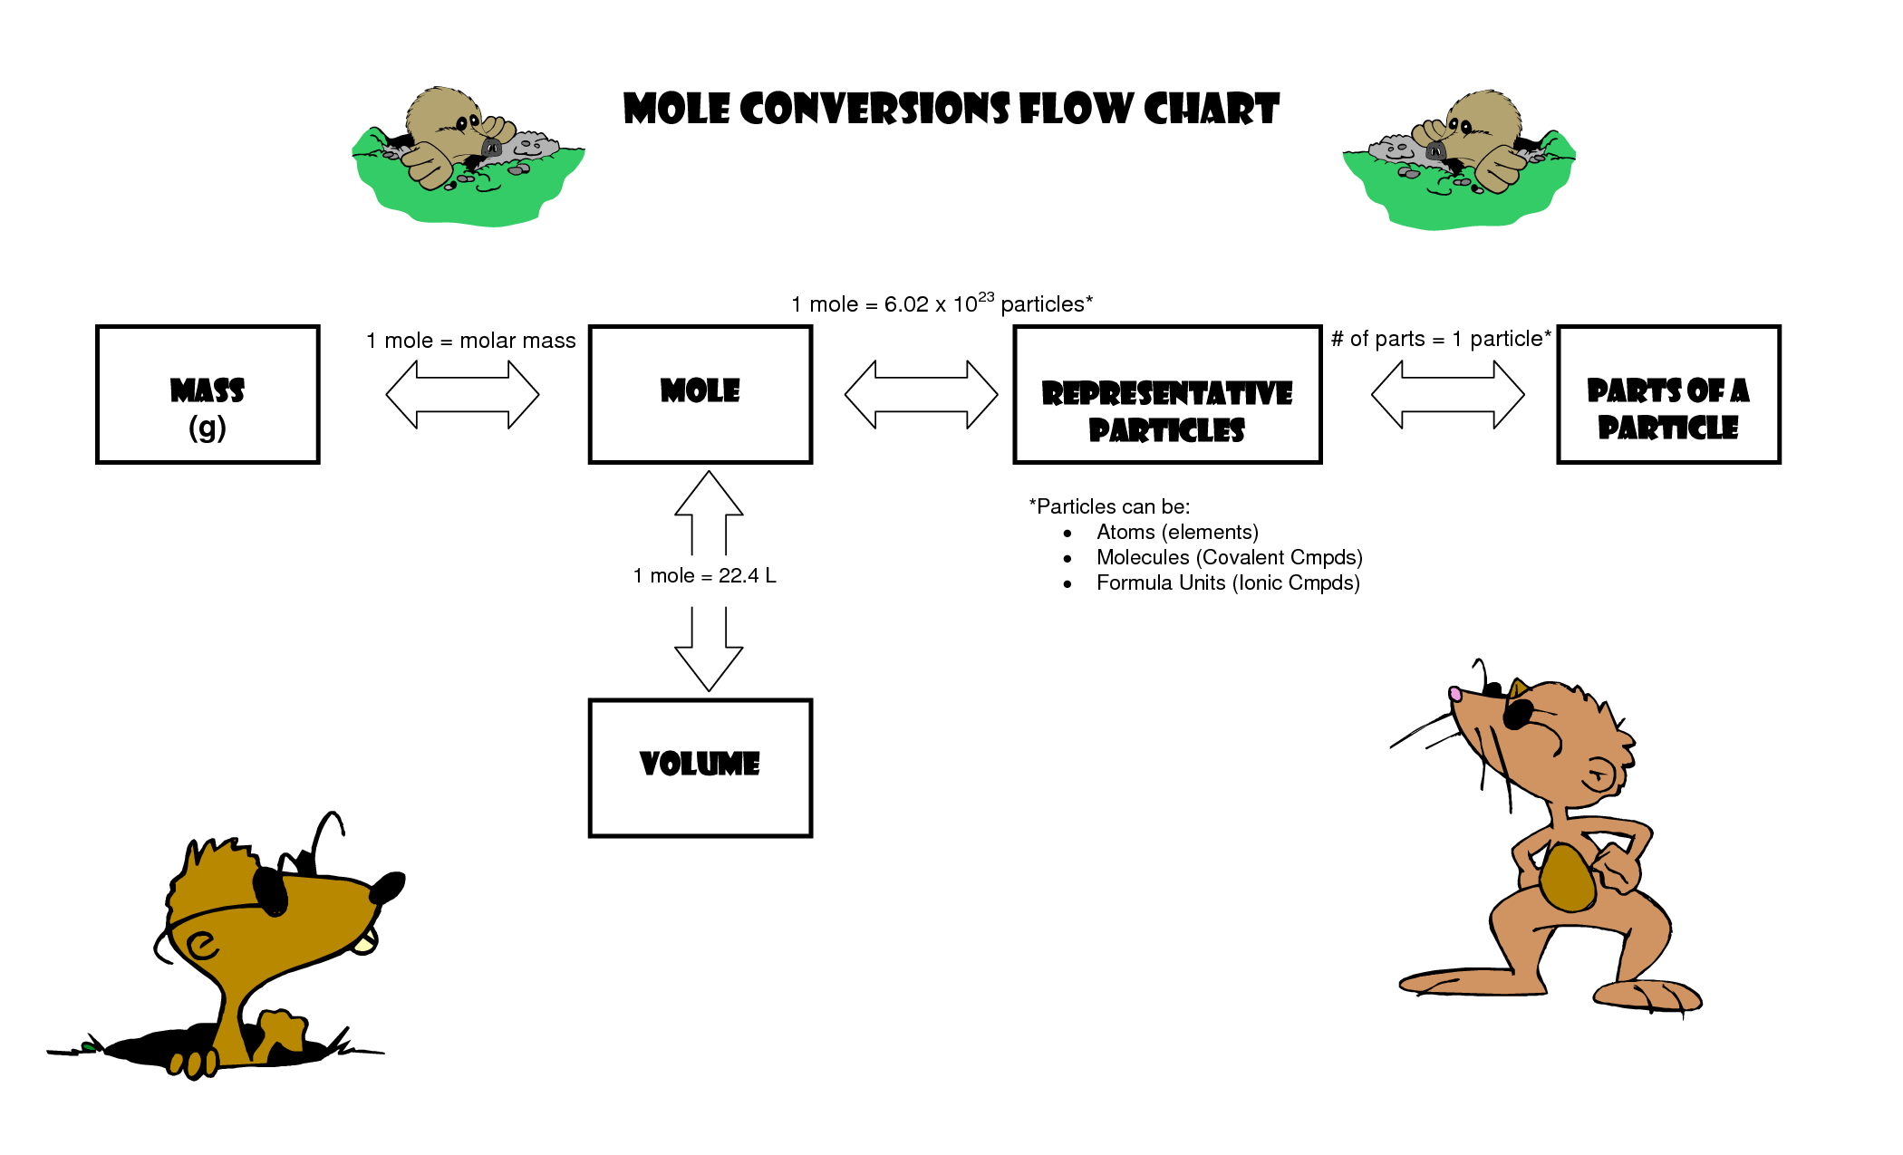
Chemistry reminders:
Atomic number = number of protons
Atomic mass = number of protons and neutrons (more or less)
Molecular mass = the sum of the atomic masses of the atoms in a molecule
Mole = the number of atoms in 12 g of Carbon = 6.02 x 10²³ (abbreviated mol!)
Molar mass = the mass, in g, of one mole of a substance

Slide 8
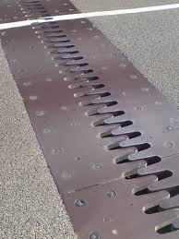
Add some energy to those molecules!
If molecules have more energy they will move more
If they move more, they take up more space!
Thermal Expansion: an increase of volume due to an increase in temperature.

Slide 9
Volumetric expansion
The change in volume depends on:
The initial volume, $V_{i}$
The change in temperature, $∆T$
Something about the material, $β$, the coefficient of volumetric expansion
$$∆V= βV_{i}∆T$$
CARD!!

Slide 10
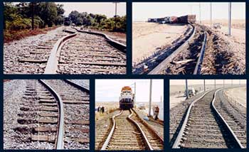
Linear expansion
The change in length depends on:
The initial volume, $L_{i}$
The change in temperature, $∆T$
Something about the material, $α$, the coefficient of linear expansion
$$∆L= αL_{i}∆T$$
CARD!!

Slide 11
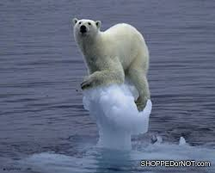
Water is weird!

Slide 12
Sample problem:
Consider a 2 m long brass rod and a 1 m long aluminum rod. When the temperature is 22 °C, there is a gap of 1.0 x 10⁻³ m separating their ends. No expansion is possible at the other end of either rod. At what temperature will the two bars touch?
Notes:
This is similar to problem 12.20 in the text. Consider a 2 m long brass rod and a 1 m long aluminum rod. When the temperature is 22 °C, there is a gap of 1.0 x 10⁻³ m separating their ends. No expansion is possible at the other end of either rod. At what temperature will the two bars touch?
The change in temperature is the same for both, the original length is known for both, and the coefficients of linear expansion can be found from Table 12.2 in the textbook.
Both rods will expand when heated. They will touch when the sum of the two length changes equals the initial width of the gap. Therefore:
So, the temperature change is:
If the original temperature was 22 °C, the final temperature is 38.4 °C

Slide 13
Gas Laws lab:
Work in pairs- one from each class
Extra points for
Mixed gender group
Mixed grade group
One, and only one, person born in another state
One, and only one, person currently enrolled in a visual arts class

