Slide 1
ANNOUNCEMENTS:
Lab today and Thursday
Test-o-rama continues
Joseph! This weekend (E.C.)
Unit II-4 Exam and HW due Friday 3/11!
Week after next: Spring Break!!!!

Slide 2
Unit II-4: Thermodynamics
Part II: Heat and Heat Transfer

Slide 3
So hot….

Slide 4
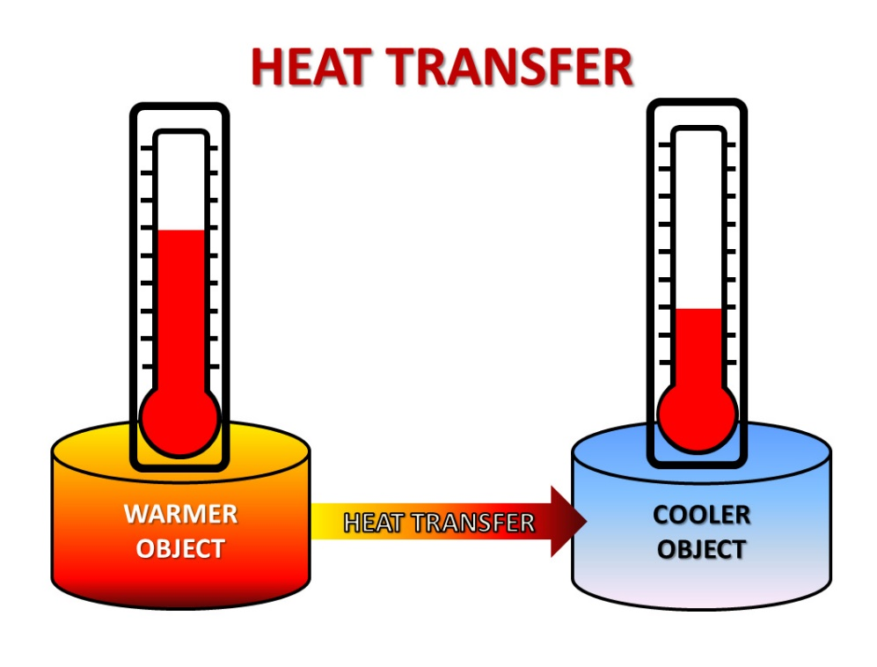
heat
The non-mechanical transfer of energy to or from the environment to the system due to a temperature difference between the two.
Contrast with WORK: the mechanical transfer of energy.
Use the variable Q and measured (like all energy terms) in Joules.
Like most things in nature heat transfers energy from high to low.

Slide 5
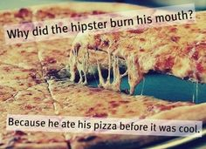
Specific heat
Specific heat, C, is the amount of heat that raises the temperature of 1 kg of a substance by 1 K.
To calculate the heat, Q, needed:
$Q=mC△$T
CARD!!

Slide 6
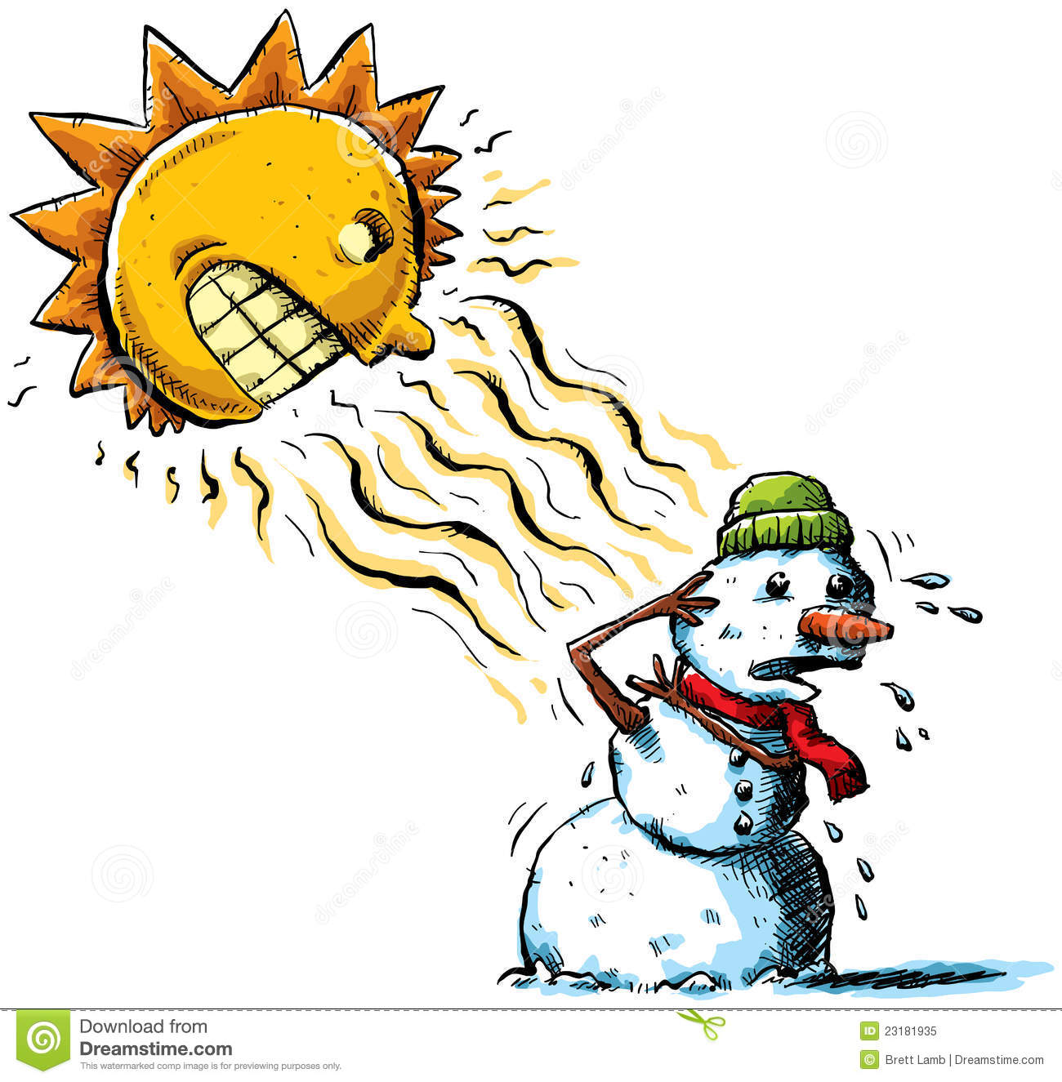
Phase changes
In addition to the heat required to change temperature, heat is required to change phase
Or is available to move into the environment
$$Q=mL_{f}$$
$$Q=mL_{v}$$
Where $L_{f}$ and $L_{v}$ are the latent heat of fusion (freezing/melting) and heat of vaporization (evaporating/condensing) respectively
CARD!!

Slide 7
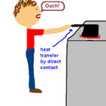
Heat transfer
There are several mechanism of heat transfer.
Conduction: transfer through direct physical contact
Is a rate (what does that look like mathematically?)
Depends on the temperature difference, $∆T$ (in Kelvin)
Depends on the area of the material, A
Depends on the length of the material, L, inversely
Depends on characteristics of the material, $k$, thermal conductivity
$$\frac{Q}{∆t}= \left(\frac{kA}{L}\right)∆T$$
CARD!!

Slide 8
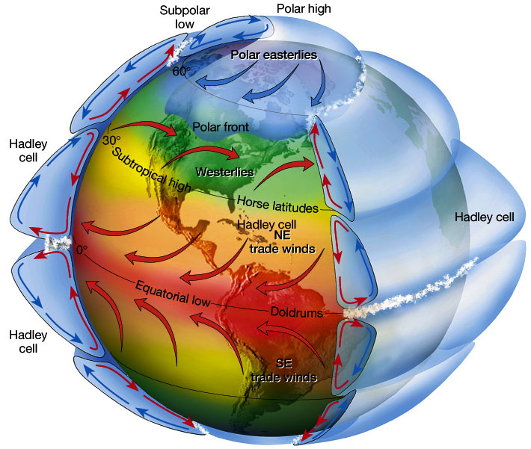
Heat transfer
Another mechanism of heat transfer.
Convection: transfer of energy by the motion of a fluid

Slide 9
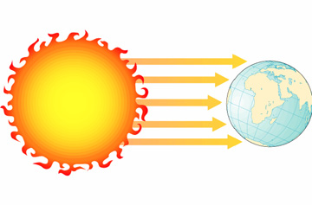
Heat transfer
And another mechanism of heat transfer.
Radiation: transfer through electromagnetic waves
Also a rate (what does that look like mathematically?)
Depends on the area of the material, A
Depends on the temperature of the material, T
Depends on characteristics of the material, $e$, emissivity
Depends on t the Stefan-Boltzmann constant, $σ=5.67 x {10}^{−8} W/m^{2}∙K^{4}$
$$\frac{Q}{∆t}=eσAT^{4}$$
CARD!!

Slide 10
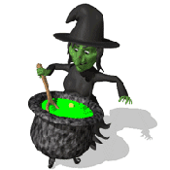
Sample problem
A big iron pot, used to boil bad children, has a bottom with a 25 cm diameter and thickness of 1 cm. The pot sits in a fire that transfers energy to the bad children soup (essentially boiling water) at 600 W. What is the temperature of the bottom surface of the pot?

