Slide 1
ANNOUNCEMENTS:
Tomorrow: Lab class and 7th
Friday: Phet class and opt 7th
Next Week: Lab Wed, Exam and HW due Friday
AP Sign ups: Have questions?
Remember colored pencils and a nice ruler!

Slide 2
Unit II-4: Thermodynamics
Part III: Energy Transformations, Thermal Energy and Temperature

Slide 3
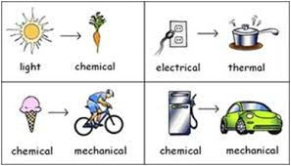
Law of conservation of energy
Energy can not be created or destroyed, but it CAN be converted from one form to another

Slide 4
It doesn’t work all that well……
Efficiency = the ratio between output and input
$\text{Often} \text{expressed} \text{as} \text{a} \text{percentage}$
$$e= \frac{W_{out}}{W_{in}} x 100$$
We can pin this on one of two sources
Process limitations: Basically design flaws
Fundamental limitations: Physics!
CARD!!

Slide 5
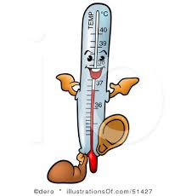
Temperature
Usually defined in terms of an ideal gas, that’s close enough!
Temperature is the average kinetic energy of the particles that make up the material.
$$K_{avg}=\frac{1}{2}mv_{avg}^{2}$$
If the material is comprised of N particles then the thermal energy is:
$$E_{th}=\frac{1}{2}Nmv^{2}$$
CARD!!

Slide 6
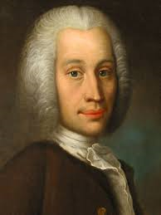
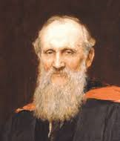
Temperature scales
There are several scales in use today.
Farenheit: that’s just ridiculous. We won’t bother with it!
Celsius:
Developed by Anders Celsius in 1742
Sets 0°C at the freezing point of pure water.
Sets 100°C at the boiling point of pure water.
Divides the difference into 100 degrees.
Kelvin:
Developed by Lord William Thomson Kelvin in 1848
Sets 0K at the point where molecular motion stops
Goes up by the same increments as Celsius
0°C = 273K

Slide 7
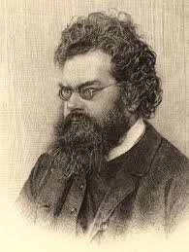
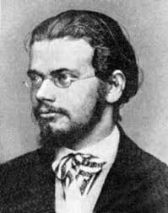
Calculating temperature from kinetic energy
Temperature: Depends on average kinetic energy and another quantity….
Boltzmann’s Constant = 1.38 x 10⁻²³ J/K
Ludwig Boltzmann, Austrian, 1877 (really Planck)
Turns up in all kinds of science
$$T= \frac{2}{3}\frac{K_{avg}}{k_{B}}$$
CARD!!

Slide 8
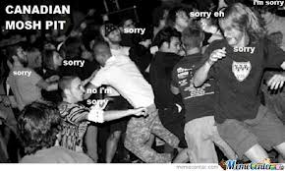
Thermal energy from temperature
Simply rearrange the previous equation with the definition of thermal energy:
$$E_{th}=\frac{3}{2}Nk_{B}T$$
CARD!!

