Slide 1
ANNOUNCEMENTS:
This week: Lab Wednesday, Thursday optional review, Unit II-4 Exam and HW due (6) Friday
Tuesday lunch: Chris Romanoski talks about rockets in the amphitheater- GO!
Missing class this week? See me about make ups BEFORE you go. Grades wrap on Friday.
Next 2 weeks- Spring Break!!!
James Webb Telescope talk- Thursday 3/24, 5:30 at AMSE
After break: Lab and/or AP Review pretty much EVERY day……..
AP Physics 1 EXAM- 37 days after Spring Break!!
Not taking the AP? Lets talk about the final(s)!

Slide 2
Unit II-4: Thermodynamics
Part IV: 1st Law of Thermodynamics

Slide 3
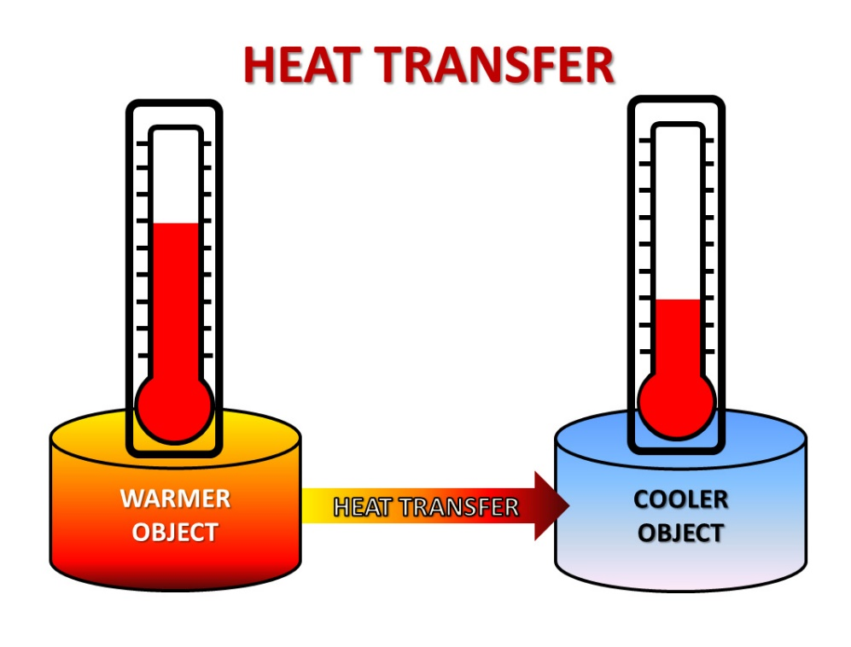
heat
The non-mechanical transfer of energy to or from the environment to the system due to a temperature difference between the two.
Contrast with WORK: the mechanical transfer of energy.
Use the variable Q and measured (like all energy terms) in Joules.
As is typical of nature, heat transfers energy from high to low.

Slide 4
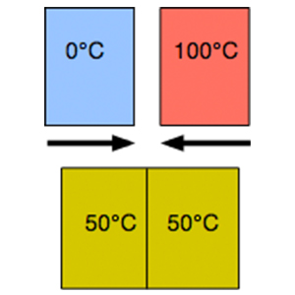
Heat from an atomic perspective
Thermal energy is transferred from faster moving atoms to slower moving atoms
Until thermal equilibrium is reached.

Slide 5
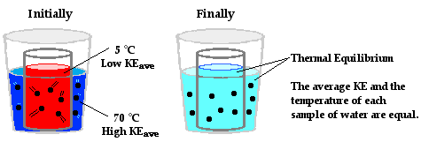
Thermal equilibrium:
At thermal equilibrium two systems in contact will have the same temperature.
In order to reach thermal equilibrium the heat lost by one system will equal the heat gained by the other.
Heat will be lost by the hotter system (more energetic) and gained by the cooler system (less energetic)

Slide 6
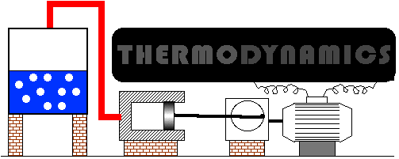
thermodynamics
The study of the relations between heat (Q) and other forms of energy

Slide 7
Laws of thermodynamics

Slide 8
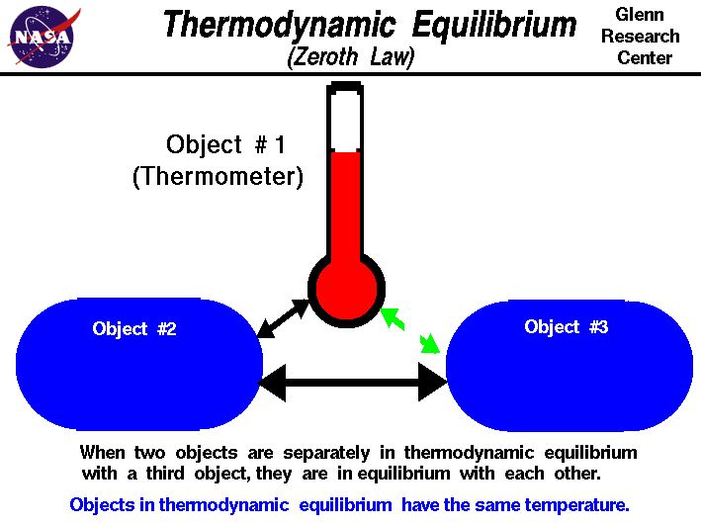
The zeroeth law of thermodynamics
Discovered last, but most important, so…….0th Law
Heat is a transitive property
If A = B and B= C, then A = C

Slide 9
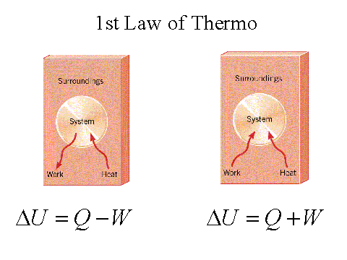
1st law of thermodynamics
The change in thermal energy is equal to the energy transferred into or out of the system as work, W and/or heat, Q.
$$∆E_{th}=W+Q$$
CARD!!

Slide 10
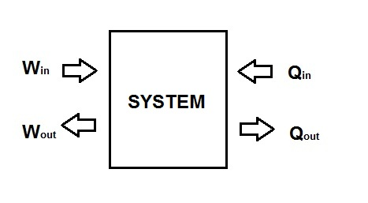
Sample Problem:
The internal energy of a system decreases by 200J. If 50 J of work is done BY the gas, how much energy is transferred as heat? Is the work done positive or negative?
Notes:
-200 = U - 50 (answer: -150J; work done is positive.)

