Slide 1
ANNOUNCEMENTS:
Today: Last Lesson
Ice Cream Lab due now
Phet due tomorrow
Friday: Unit II-4 Test and HW due (6 assignments)
Next 2 Weeks: Spring Break!!!
Get optics supplies!

Slide 2
Unit II-4: Thermodynamics
Part V: Heat Engines, The Second and Third Laws of Thermodynamics

Slide 3
Laws of thermodynamics

Slide 4
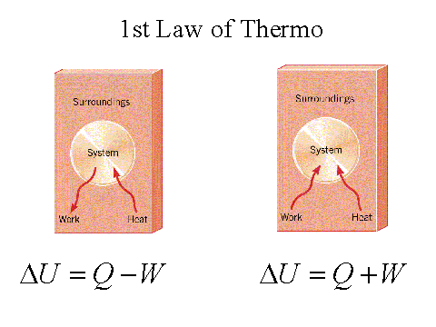
1st law of thermodynamics
The change in thermal energy is equal to the energy transferred into or out of the system as work, W and/or heat, Q.
$$∆E_{th}=W+Q$$
Also known as “You Can’t Win”
CARD!!

Slide 5
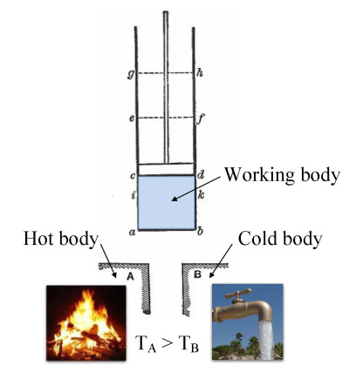
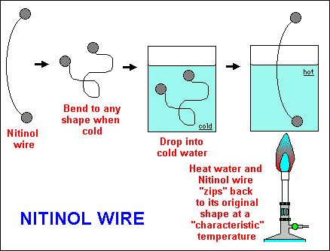
Heat engines
A device that produces motive power from heat, such as a gasoline engine or steam engine.

Slide 6
Efficiency of a heat engine
Don’t work too well….. (theme here?)
Maximum efficiency of a heat engine, e_{max}
$$e_{max}=\left(1 − \frac{T_{C}}{T_{H}}\right) x 100$$
This number will ALWAYS be less than 100%!
CARD!!

Slide 7
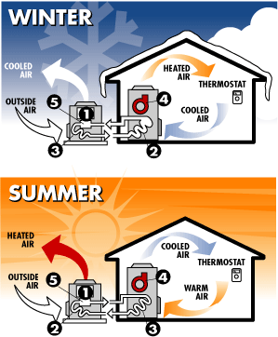
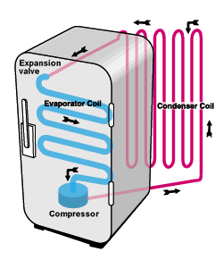
Heat pumps
A device that forces energy to flow from cold to hot
Refrigerator
Air conditioner
Heating system
But these don’t work too well either….

Slide 8
The Second Law of thermodynamics
Kelvin & Planck "No (heat) engine whose working fluid undergoes a cycle can absorb heat from a single reservoir, deliver an equivalent amount of work, and deliver no other effect“
Clausius "No machine whose working fluid undergoes a cycle can absorb heat from one system, reject heat to another system and produce no other effect“
Either way: You can’t get out everything you put in- no complete conversions are possible.
YOU CAN’T BREAK EVEN!

Slide 9
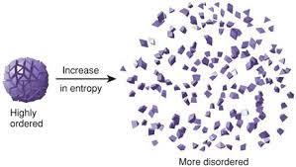
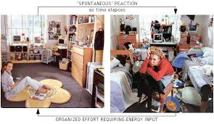
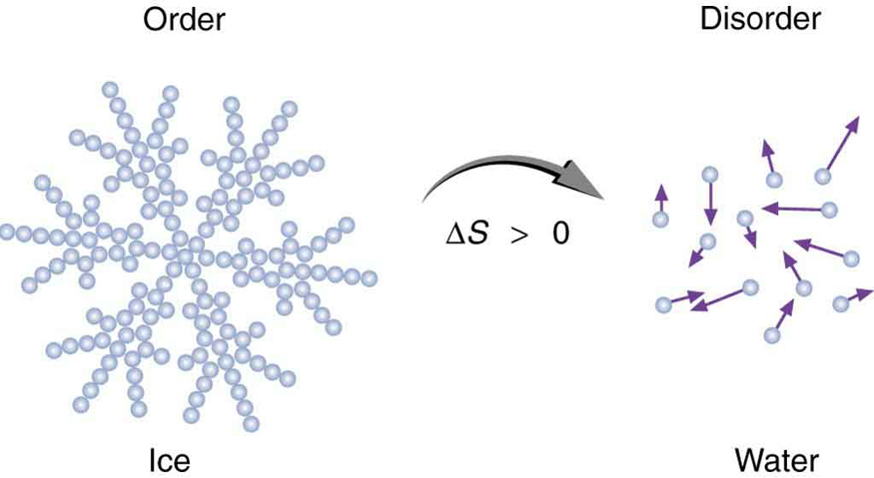
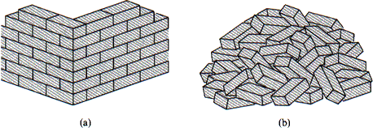
Dictates the direction of processes
The most probable state is equilibrium.
Equilibrium tends to be more disordered.
Entropy: the measure of disorder in a system (actually, probability of a certain state)
Written another way the 2nd Law states:
The entropy of an isolated system never decreases.

Slide 10
Related statements:
When two systems of different temperatures interact, heat ALWAYS moves from hot to cold, NEVER from cold to hot.
It is impossible to create a heat engine that converts all thermal energy to work.
It is impossible to create a heat pump that moves heat from cold to hot without energy input.
The time direction in which the entropy of an isolated system increases is “the future”.

Slide 11
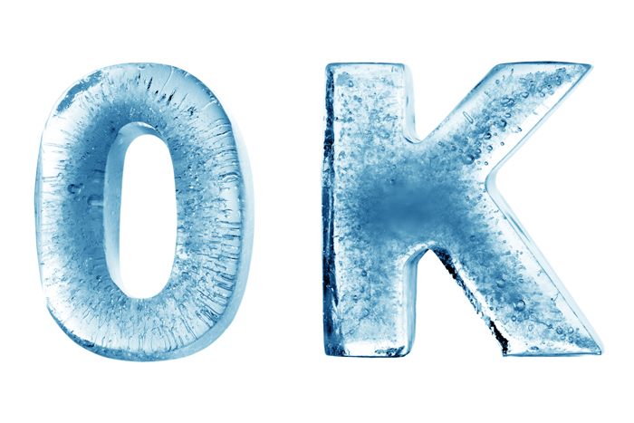
3rd law of thermodynamics:
The entropy of a perfect crystal is zero when the temperature of the crystal is equal to absolute zero (0 K)

Slide 12
3rd Law of thermodynamics
The Third Law of Thermodynamics is concerned with the limiting behavior of systems as the temperature approaches absolute zero.
Most thermodynamics calculations use only entropy differences, so the zero point of the entropy scale is often not important.
We discuss the Third Law for purposes of completeness because it describes the condition of zero entropy.

Slide 13
Thermodynamics EXIT TICKET:
Use the interwebs to research “Heat Death of the Universe”
Write a brief summary of your findings
In the last paragraph summarize your feelings about your findings.

