Slide 1
ANNOUNCEMENTS
Test repair tomorrow 7:20
lab tomorrow: Bring an empty plastic water bottle!
Class labs Wednesday and Friday
Review sessions begin Wednesday 3/30
About 2-3/week until the end
AAPT Physics bowl exam Thursday 4/7 1st and 2nd
Unit II-5 Exam and HW due Friday 4/8
Pencils, etc… for 4/11

Slide 2
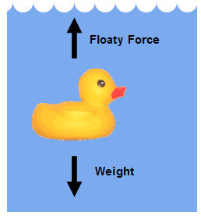
UNIT II-5: FLUIDS
Section 1: Fluids and the Buoyant Force

Slide 3
Defining a Fluid
A fluid is a nonsolid state of matter in which the atoms or molecules are free to move past each other, as in a gas or a liquid.
Both liquids and gases are considered fluids because they can flow and change shape.
Liquids have a definite volume; gases do not.

Slide 4
pressure
Pressure is the magnitude of the force on a surface per unit area
$$P= \frac{F}{A}$$
Unit = $\frac{N}{m^{2}}=Pascal=pa$

Slide 5
PASCAL’S PRINCIPLE
Pascal’s principle states that pressure applied to a fluid in a closed container is transmitted equally to every point of the fluid and to the walls of the container.
$$P= \frac{F}{A} and P_{1}= P_{2}$$
$$\frac{F_{1}}{A_{1}}=\frac{F_{2}}{A_{2}}$$
CARD!

Slide 6
APPLICATION OF PASCAL’S PRINCIPLE:

Slide 7
Pressure
Chapter 8
Pressure is the magnitude of the force on a surface per unit area.
Let’s look at that again…..
$$P= \frac{F}{A}$$
When we talk about a fluid we usually say ‘depth’ not Height.
$$P= P_{0}+ ρgd$$
$$= \frac{mg}{A}$$
$$= \frac{ρVg}{A}$$
$$= \frac{ρAhg}{A}$$
$=ρhg$
CARD!

Slide 8
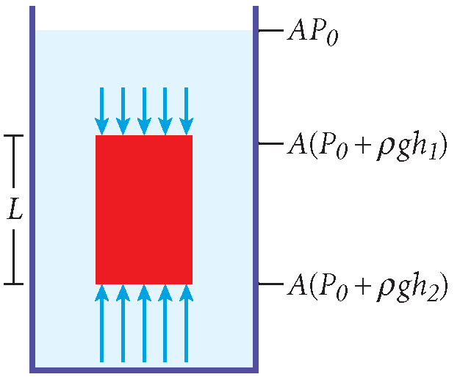
FLUID PRESSURE AS A FUNCTION OF DEPTH
Force = pressure x area
The pressure in a fluid increases with depth.
The force in a fluid increases with depth.
Net Force is the sum of the upward (buoyant) force and the downward (pressure) force.

Slide 9
FLUID PRESSURE AS A FUNCTION OF DEPTH
$P_{top}=−\left(P_{0}+ ρgh_{1}\right)$
$P_{bot}=\left(P_{0}+ ρgh_{2}\right)$
$F=AP$
$F_{net}=A\left(P_{0}+ ρgh_{2}\right)−\left(P_{0}+ ρgh_{1}\right)$
$=ρgA(h_{2}−h_{1})$
$=ρVg$
$=m_{f}g$
This is just Archimedes’ Principle!

Slide 10
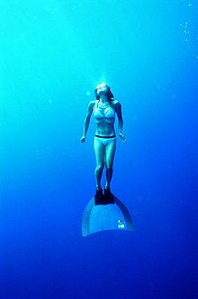
EFFECTS OF PRESSURE ON THE HUMAN BODY
http://www.history.com/shows/stan-lees-superhumans/videos/deep-sea-diver

Slide 11
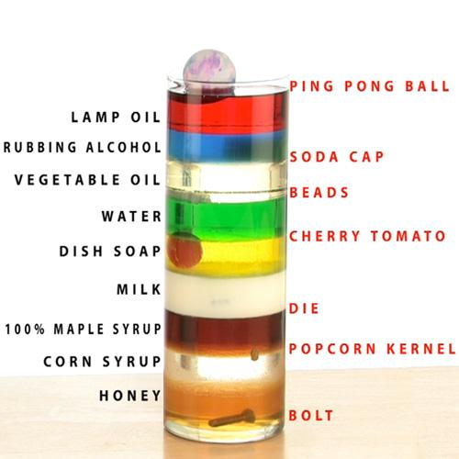
Density
The concentration of matter of an object is called the mass density.
Mass density is measured as the mass per unit volume of a substance.
$$ρ= \frac{m}{V}$$
CARD!!

Slide 12
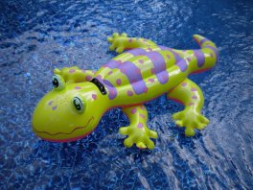
DENSITY AND BUOYANT FORCE,
The buoyant force is the upward force exerted by a liquid on an object immersed in or floating on the liquid.
Buoyant forces can keep objects afloat.

Slide 13
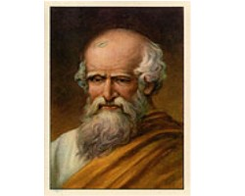
DENSITY AND BUOYANT FORCE,
Archimedes’ principle describes the magnitude of a buoyant force.
Archimedes’ principle: Any object completely or partially submerged in a fluid experiences an upward buoyant force equal in magnitude to the weight of the fluid displaced by the object.
$$F_{B}= F_{f}= m_{f}g$$
magnitude of buoyant force = weight of fluid displaced
You should put this on your card!

Slide 14
Displaced Volume of a Fluid
Chapter 8

Slide 15
DENSITY AND BUOYANT FORCE
For a floating object, the buoyant force equals the object’s weight.
The apparent weight of a submerged object depends on the density of the object.
For an object with density ρ_{O} submerged in a fluid of density ρ_{f}, the buoyant force F_{B} obeys the following ratio:
$$\frac{F_{g}}{F_{B}}=\frac{ρ_{O}}{ρ_{f}}$$
CARD!!

Slide 16
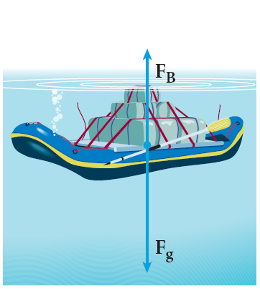
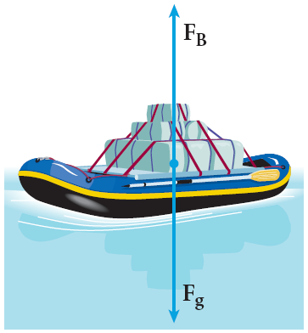
Buoyant Force

Slide 17
Sample Problem
A bargain hunter purchases a “gold” crown at a flea market. After she gets home, she hangs the crown from a scale and finds its weight to be 7.84 N. She then weighs the crown while it is immersed in water, and the scale reads 6.86 N. Is the crown made of pure gold?

