Slide 1
ANNOUNCEMENTS:
Cartesian Diver lab due last night!
Archemede’s Principle lab due tonight midnight
Today 7th period review
Next week:
Phet lab Monday
Lab Review Tuesday
Class/Lab Wednesday
Physics Bowl Thursday 1st and 2nd: Study hall class period
Unit II-5 Exam and HW due Friday

Slide 2
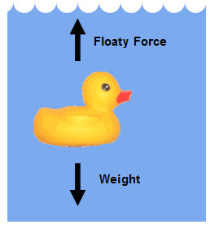
UNIT II-5: FLUIDS
Section 2: Fluids in Motion

Slide 3
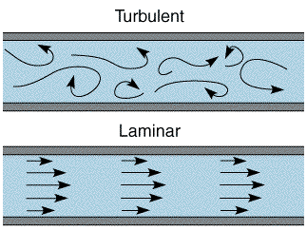
Fluid Flow
Moving fluids can exhibit laminar (smooth) flow or turbulent (irregular) flow.
2

Slide 4
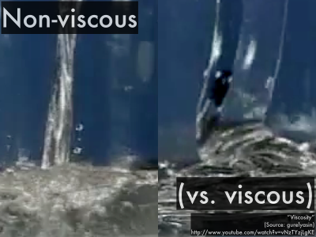
Fluid Flow
An ideal fluid is a fluid that has no internal friction or viscosity and is incompressible.
The ideal fluid model simplifies fluid-flow analysis.
More on viscosity later in this unit!

Slide 5
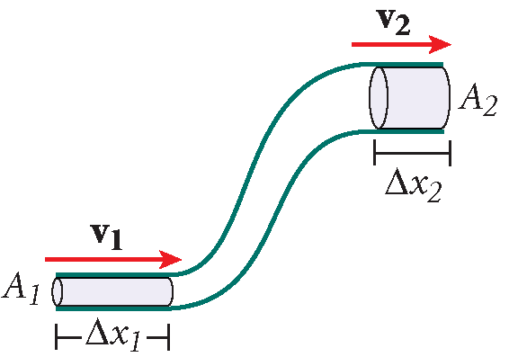
Principles of Fluid Flow
The continuity equation results from conservation of mass.
Continuity equation
$A1v1 = A2v2$
Area × speed in region 1 = area × speed in region 2
CARD!

Slide 6
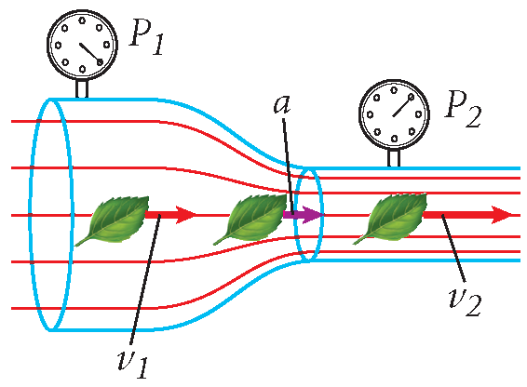
PRINCIPLES OF FLUID FLOW
The speed of fluid flow depends on cross-sectional area.
Bernoulli’s principle states that the pressure in a fluid decreases as the fluid’s velocity increases.

Slide 7
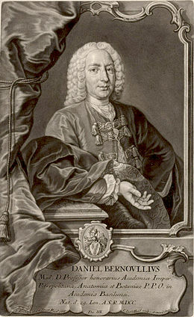
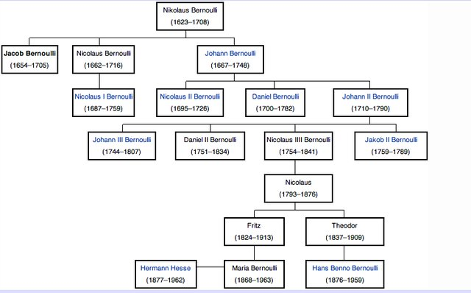
bernoulli
In this chapter: Daniel Bernoulli, 1700-1782
But there are more!

Slide 8
AIRPLANES:

Slide 9
CARS

Slide 10
TORNADOS

Slide 11
Bernoulli’s equation:
The result of law of conservation of energy and Bernoulli’s principle:
Relates pressure, velocity and height at any two points in an ideal fluid
$$p_{2}+ \frac{1}{2}ρv_{2}^{2}+ρgy_{2}=p_{1}+ \frac{1}{2}ρv_{1}^{2}+ρgy_{1}$$
CARD!

Slide 12
