Slide 1
ANNOUNCEMENTS:
Phet Lab due thursday
Lab class and 7th tomorrow
AAPT Physics bowl exam 1st and 2nd Thursday
Unit II-5 Test and HW due Friday
Pencils/rulers Monday!!!
Unit II-6 Exam and HW due 4/26

Slide 2
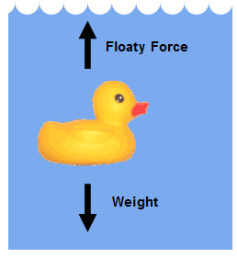
UNIT II-5: FLUIDS
Section 3: viscosity

Slide 3
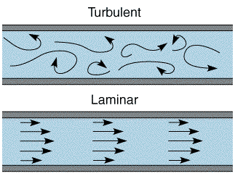
Fluid Flow
Moving fluids can exhibit laminar (smooth) flow or turbulent (irregular) flow.
2

Slide 4
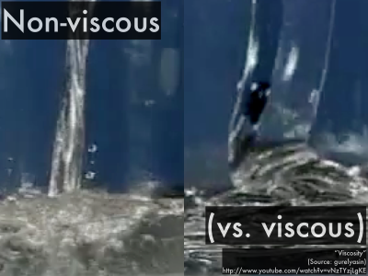
Fluid Flow
An ideal fluid is a fluid that has no internal friction or viscosity and is incompressible.
The ideal fluid model simplifies fluid-flow analysis.
More on viscosity now!

Slide 5
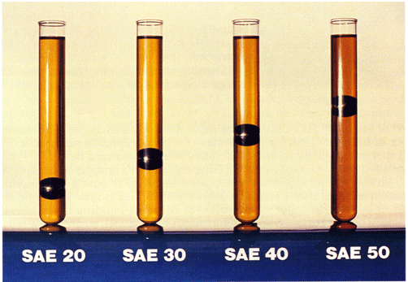
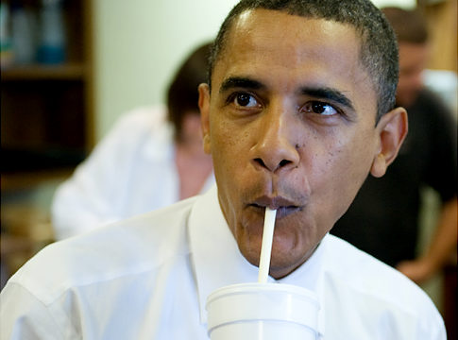
viscosity
A property of a fluid that measures its resistance to flow.
Requires a pressure difference to keep the fluid flowing

Slide 6
Calculating viscosity
The pressure differential to keep a fluid moving at a velocity, $v$, in a pipe depends on
The velocity, $v$
The length of the pipe, $L$
the inverse of the area, $A$
And something about the fluid, the coefficient of viscosity, $η$
For an ideal fluid $η=0$

Slide 7
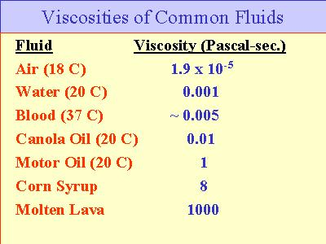
Coefficient of viscosity
Unit $=N∙s/{m^{2}}=Pa∙s=Poise$
1 poise $=0.1 Pa∙s$

Slide 8
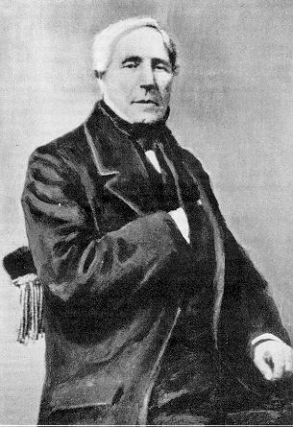
Poiseuille’s equation
Jean Poiseuille
French, 1797-1869
Medical doctor
First to use a sphygomanometer

Slide 9
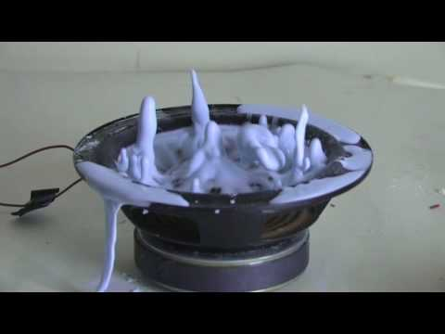
Caution! Newtonian fluids only!
Poiseuille’s equation only applies to Newtonian fluids. The limitation of laminar flow also applies
But non-Newtonian fluids are cool!

Slide 10
Poiseuille’s equation
Defined for average speed, $v_{avg}$
Usually solved for volume flow rate, $Q= {∆V}/{∆t}$
$$Q= v_{avg}A=\frac{πR^{4}∆p}{8ηL}$$
CARD!

