Slide 1
Announcements:
Test Repair: Tomorrow 7:20 am or after school until 3:30
Review sessions lab periods until Tuesday
Unit II-7 HW due Monday 5/9
AP Exam(s): 5 DAYS!

Slide 2
Unit I-7: Modern, Quantum & Nuclear Physics Section 1: Relativity

Slide 3
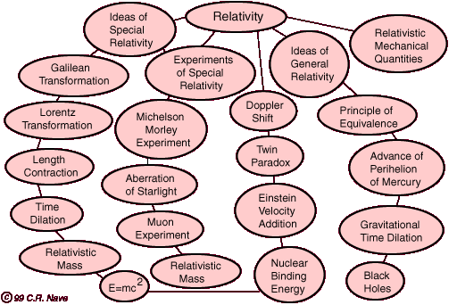
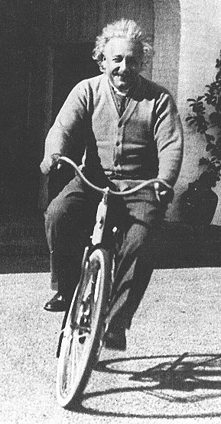
RELATIVITY

Slide 4
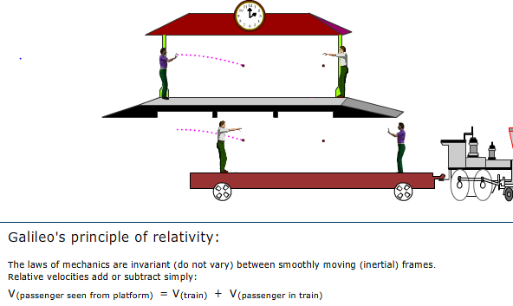
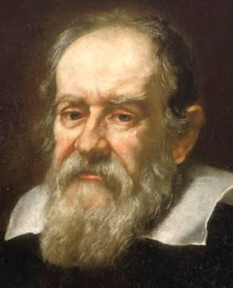
Galileo’s Principle of Relativity

Slide 5
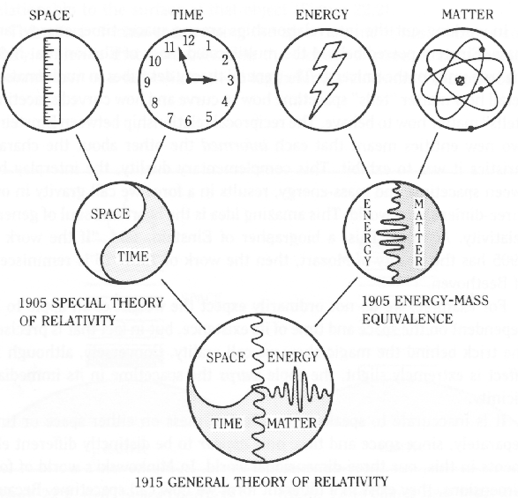
Special and General Relativity
Special Relativity: a framework for translating physical events/laws into forms for any inertial reference frame.
$→$ space and time are not absolute, depend upon the inertial reference frame of the observer!
General Relativity: extends these ideas into forms appropriate for accelerated reference frames and gravity.
$→$the presence of matter causes warps and curves in space-time

Slide 6
Two Postulates of Special Relativity
The Relativity Postulate: The laws of physics are the same for all observers moving at constant velocity, regardless of what their actual velocity is. An observer moving at constant velocity is said to be in an inertial reference frame.
The Speed of Light Postulate: The speed of light in a vacuum is the same value (c=3 x10⁸ m/s) in all directions and in all inertial reference frames.

Slide 7
Another View of Postulate #2: Nothing travels faster than light
The speed of light, c, is the universal speed limit. As an object approaches the speed of light, its mass increases and more force must be exerted to produce a given acceleration.
Force causes an object to speed up, so eventually its speed will surpass the speed of light!
Applying a force causes the object to either speed up and/or gain mass!
The relativistic momentum and relativistic energy approach infinity at the speed of light. Since the net applied force is equal to the rate of change of momentum and the work done is equal to the change in energy, it would take an infinite time and an infinite amount of work to accelerate an object to the speed of light.

Slide 8
Special Relativity Thought Experiment #1: The Relativistic Train
In General:
Two observers in different inertial reference frames (traveling at constant, but different, velocities) *see* the same experiment that involves the motion of light.
They agree that the speed of light is the same, but that the distance traveled by the light is different.
They will not agree on how much time has elapsed during the experiment.

Slide 9
Special Relativity Thought Experiment #1: The Relativistic Train
A Specific Example, The Relativistic Train: Consider an experiment where an observer ( ) standing on a very wide train car shines a light across the train car to a mirror ( ) on the other side and measures how long it takes the light to return. Let’s consider what is going on from the perspective of the observer that shines the laser and from an observer who watches the experiment from a *stationary* location beside the train tracks ( ):
Direction of motion of the
train as seen by the
*stationary* observer

Slide 10
What does the observer on the train car see?
The person on the train car sees the light travel across the train car, bounce off the mirror, and return. The length the light travels will be equal to 2D from their perspective, and the time that passes during the experiment is ∆t_{o}.
D

Slide 11
What does the observer standing beside the tracks see?
The person standing beside the tracks sees the motion of the train car during the experiment. The length the light travels will be equal to 2L from their perspective, and the time that passes during the experiment is ∆t.
D
L
L
v
v
v
vΔt

Slide 12
Something’s Got to Give!
The time that the stationary observer perceives to have elapsed will always be greater than the elapsed time the moving observer will perceive to have elapsed .
If their watches are synchronized at the beginning of the experiment, they will disagree at the end of the experiment!
Notes:
The two observers agree that the speed of light is the same, but they *perceive* that the light has traveled different distances (2D .vs. 2L). This requires that the time that has passed during the experiment will be different for the two observers, with the observer in the *fixed* reference frame measuring a longer interval of time! We can show this algebraically by eliminating the lengths from the equation for L and expressing on of the time intervals in terms of the other:

Slide 13
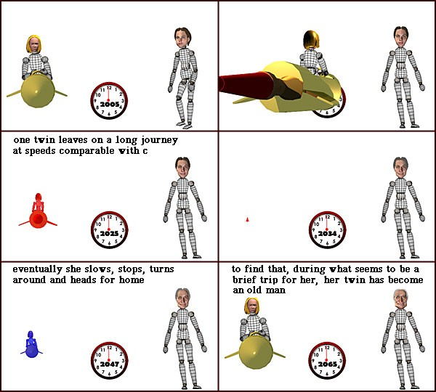
Special Relativity Thought Experiment #2: The Twin Paradox
Notes:
One of a pair of twins leaves on a high speed space journey during which she travels at a large fraction of the speed of light while the other remains on the Earth. Because of time dilation, time is running more slowly in the spacecraft as seen by the earthbound twin and the traveling twin will find that the earthbound twin will be older upon return from the journey.
Experiments on a commercial airline confirm the existence of a time difference between ground observers and a reference frame moving with respect to them.

Slide 14
Special Relativity: Ideas and Confirming Experiments

Slide 15
Proper Time and Time Dilation
Proper Time: If two successive events occur at the same place in an inertial reference frame then the time interval, measured on a single clock at that location, is the proper time between the two events.
Time Dilation: An observer in any other inertial reference frame will measure a time that is longer than the proper time. If this second observer is moving with a relative speed v, than the measured time interval will be given by:

Slide 16
Proper Length and Length Contraction
Proper Length: The length of an object measured by an observer in the inertial reference frame in which the object is at rest is called its proper length.
Length Contraction: An observer in any other inertial reference frame will measure a length that is shorter than the proper length. If this second observer is moving with a relative speed v, than the measured length will be given by:

Slide 17
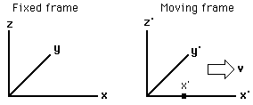
Comparing Observations made in Different Reference Frames
Suppose we want to compare how observers moving at different, but constant, velocities *view* the results of the same experiment. If an observer moving at a constant velocity (v) in the x-direction sees an object at the space-time location (x’,y’,z’,t’), then a person who is not moving will see the object at (x,y,z,t):

Slide 18
Comparing Observations made in Different Reference Frames
The Galilean Transformation is accurate (and what we are used to) if speeds are slow relative to the speed of light

Slide 19
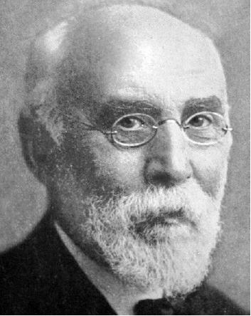
Comparing Observations made in Different Reference Frames
The Lorentz transformation incorporates relativistic considerations. Note that it simplifies to the Galilean Transformation if v is much less than c.

Slide 20
General Relativity

Slide 21
Principle of Equivalence
An observer in the *elevator* cannot distinguish between experiments completed when the elevator is at rest in a gravitational field and when the elevator is accelerating at
a = -g
Notes:
Experiments performed in a uniformly accelerating reference frame with acceleration a are indistinguishable from the same experiments performed in a non-accelerating reference frame which is situated in a gravitational field where the acceleration of gravity = g = -a = intensity of gravity field. One way of stating this fundamental principle of general relativity is to say that gravitational mass is identical to inertial mass. One of the implications of the principle of equivalence is that since photons have momentum and therefore must be attributed an inertial mass, they must also have a gravitational mass. Thus photons should be deflected by gravity. They should also be impeded in their escape from a gravity field, leading to the gravitational red shift and the concept of a black hole.

Slide 22
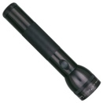
Gravity Bends Light Thought Experiment
Notes:
For an elevator accelerating through space at a = -g: If a light source shines through a pinhole in the side of the elevator, it will appear to the observer that the path of the light bends as it travels through the elevator.
The pulse of light travels straight across the interior of the elevator, but from the perspective of the person in the accelerating elevator the path is bent toward the floor.
Hence, by the Principle of Equivalence … an observer in an elevator at rest will observe identical results!
Thus, we conclude that
gravity bends light!
The Principle of Equivalence indicates that identical results must be perceived by an observer in an elevator at rest on earth!

Slide 23
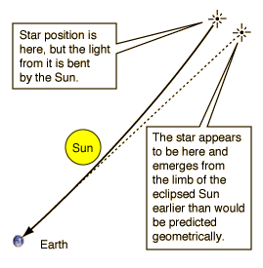
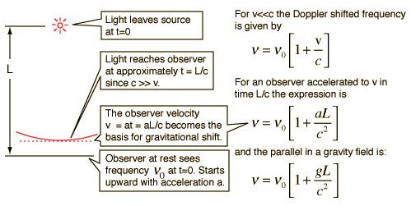
Confirming Experiments:
Gravitational Deflection of Light:
Gravitational Red Shift:
Notes:
Einstein's calculations in his newly developed general relativity indicated that the light from a star which just grazed the sun should be deflected by 1.75 seconds of arc. It was tested during the total eclipse of 1919 and during most of those which have occurred since.
According to the principle of equivalence from general relativity, any frequency shift which can be shown to arise from acceleration of a radiating source could also be produced by the appropriate gravitational field.

Slide 24
Confirming Experiment: Aircraft Time Dilation
For an aircraft flying over the equator, its clocks will show a time shift relative to a fixed surface clock which can be approximately modeled by the expression:
$$T_{A}− T_{S}=−T_{S}\left[\frac{2Rωv+ v^{2}}{2c^{2}}\right]$$
Notes:
where the subscripts A and S refer to the aircraft and surface clocks. For travel eastward, v has a positive sign and the shift will be negative (aging more slowly). But for a westward flight the time shift was positive for the aircraft speeds involved (aging faster). Hafele and Keating are credited with measurements which provided experimental support for the theory behind time dilation and the twin paradox. Their results matched associated predictions with an accuracy of about 10%.

Slide 25
Confirming Experiment: Around-the-World Atomic Clocks
October 1971, Hafele and Keating
Flew cesium beam atomic clocks around the world twice on regularly scheduled commercial airline flights, once to the East and once to the West.
Both gravitational time dilation and kinematic time dilation are significant and of comparable magnitude.
Predicted: | Time difference in ns
 | Eastward | Westward
Gravitational | 144 +/- 14 | 179 +/- 18
Kinematic | -184 +/- 18 | 96 +/- 10
Net effect | -40 +/- 23 | 275 +/- 21
Observed: | -59 +/- 10 | 273 +/- 21

Slide 26
Confirming Experiment: Gravitational Time Dilation
A clock in a gravitational field runs more slowly according to the gravitational time dilation relationship from general relativity.
∆t = time interval measured by a clock far from the mass ∆t_{o} = time interval measured at a distance R from the center of the mass.

Slide 27
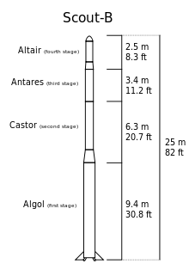
Confirming Experiment: Gravitational Time Dilation
Scout Rocket Experiment
1976, Smithsonian Astrophysical Observatory
Scout rocket to 10,000 km.
Clock should run 4.5 parts in 10¹⁰ faster than one on the Earth.
Two hours of free fall from its max. height, transmitted timing pulses from a maser oscillator which acted as a clock and which was compared with a similar clock on the ground.
This result confirmed the gravitational time dilation relationship to within 0.01%.

