Slide 1
ANNOUNCEMENTS:
Atwood Lab today and tomorrow- due 9/8
Newton’s 2nd Law Lab Wednesday-Thursday- due 9/10
Ch 5 HW Quiz Friday 9/4
Ch 5 HW due Friday 9/4
Sign up for UTED on cabinet- last day is Wednesday 9/9

Slide 2
Sample problem: Derive a formula for the tension in the string
m₁
m₂
Objective: to analyze the dynamics of a single particle under forces including tension

Slide 3
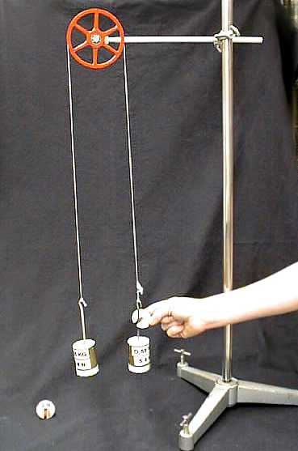
Atwood Machine Lab
Lesson 3 and Lesson 4

Slide 4
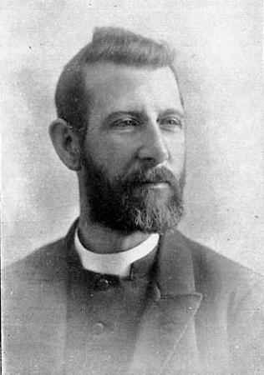
Reverend George Atwood

Slide 5
Problem: For the “Atwood machine” shown, derive an equation which can be used to find g, the gravitational acceleration, from a measured value of the acceleration of the masses.
m₂
m₁
Objective: to analyze the dynamics of a single particle under forces including tension

Slide 6
Atwood Machine Lab
Purpose: to determine gravitational acceleration using the Atwood machine.
Hypothesis:?
Theoretical Background: See on previous slide.
Procedure: Be sure to list (enumerate) your steps accurately.
Data: You are collecting data to determine acceleration. Mass is important, too. You’ll need data tables ready to record data into- prepare these before you begin.
Calculations- use the derived equation, show all steps and use units.
Objective: to analyze the dynamics of a single particle under forces including tension

