Slide 1
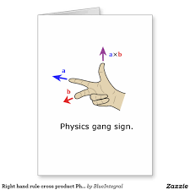
Announcements
Biot-Savart Quiz tomorrow
Time to begin Mechanics Review!
85 questions in the packet- do about 12/day
Be ready to go over them on April 11th!
Ch 28-29 Quiz 4/8

Slide 2
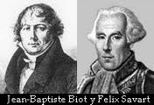
Biot-Savart Law
Calculating the magnetic field

Slide 3
Objectives

Slide 4
Biot-Savart Law
The Biot-Savart law is an experimentally deduced inverse-square law that can be used to calculate the magnetic field produced at a point in space due to various distributions of current.
It is named for Jean-Baptiste Biot and Felix Savart who discovered this relationship in 1820.
Sums, by integration, the contributions dB from all current length elements- VECTOR sums!

Slide 5
Biot-Savart Law

Slide 6
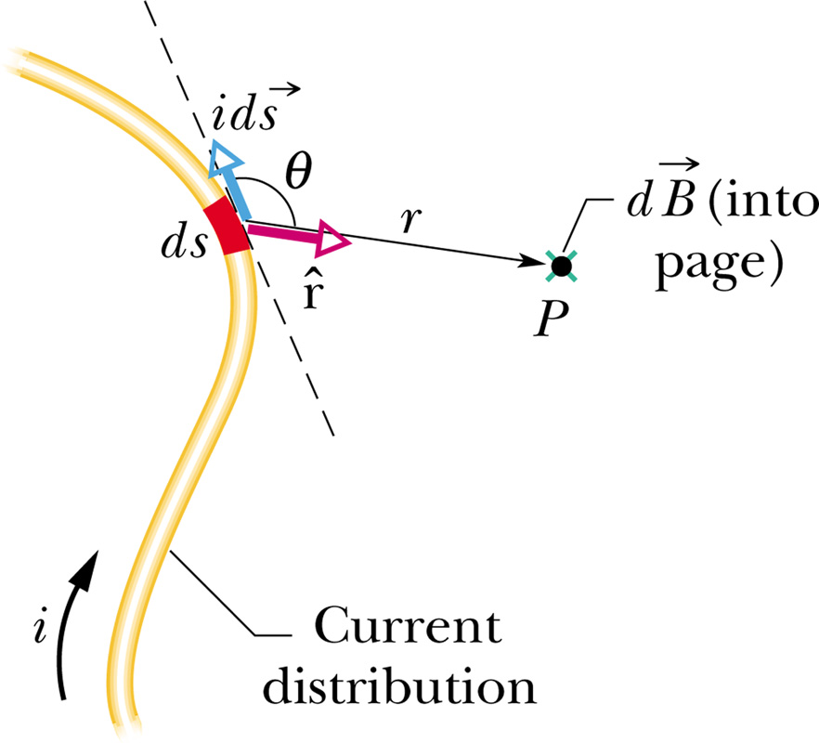
Biot-Savart Law for visual learners
afg001.jpg

Slide 7
Calculate the magnitude and direction of the magnetic field a distance R from a long straight wire bearing current i.

Slide 8
Calculate the magnitude and direction of the magnetic field in the center of a circle of radius 0.1 m if 25 A of current is flowing in the circle

Slide 9
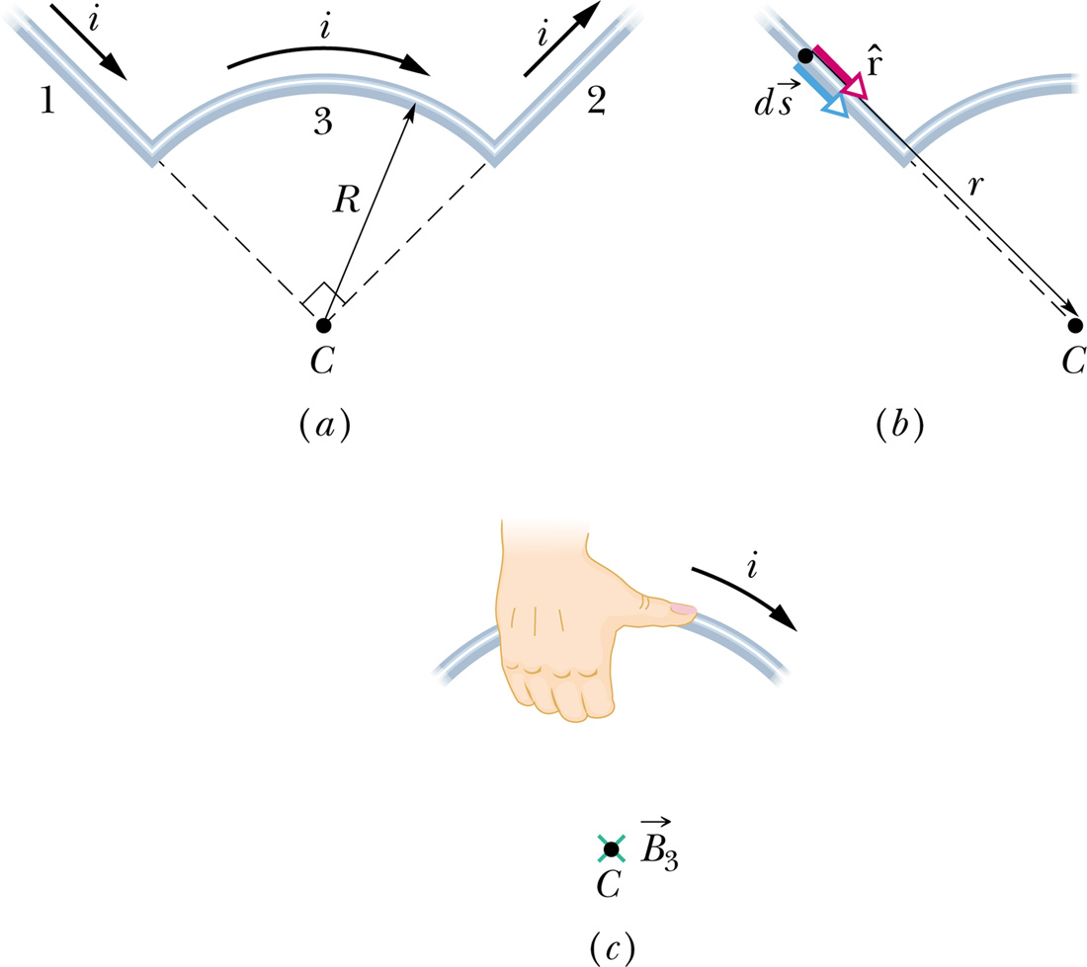
Calculate the magnitude and direction of the magnetic field in the center of the arc of radius r shown in the figure. The central angle is 90º.

