Slide 1
ANNOUNCEMENTS:
Ch 25 HW Quiz and HW due Thursday 2/11
Electrostatics Exam Monday (MC) and Tuesday (FR) 2/15-16
Resistivity Lab Wed-Fri 2/17-19
Missing class?
See Weebly for missed lessons
Make arrangements for missing assessments

Slide 2
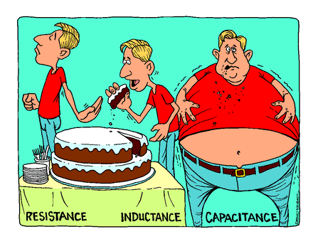
Capacitors in circuits
Electrostatics Unit

Slide 3
College Board Standards

Slide 4
Capacitors in Circuits

Slide 5
Capacitors in Series
Capacitors in series all have the same charge.
If the capacitor combination has charge Q, then each capacitor in the series also has charge Q.
This is because capacitors must obtain charge from adjacent capacitors.
The voltage difference across the combination varies inversely with the capacitance according to ΔV = Q/C

Slide 6
Equivalent Capacitance - Series
C₁
C₂
C₃

Slide 7
Capacitors in Parallel
Capacitors in parallel all have the same potential difference across their plates.
If the capacitor combination has charge Q, then the charges on all capacitors in the combination will sum to equal Q.
The larger the capacitance, the larger the fraction of the total charge on that capacitor according to Q = CΔV.

Slide 8
Equivalent Capacitance - parallel
C₁
C₂
C₃

Slide 9
Sample problem: Determine equivalent capacitance of the configuration shown
C
C
C
C
C
C

Slide 10
Sample problem: Determine equivalent capacitance between a and b. If the potential difference between a and b is 10V, what charge is stored on C3? (C1=5μF, C2=10μF, C3=2μF)
C1
a
C1
C3
C2
C2
C2
C2
b

Slide 11
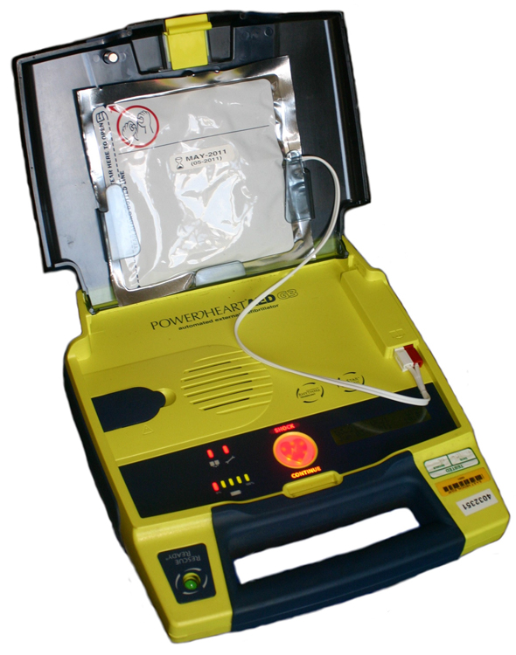
Energy Stored in Capacitors
Electrostatics Unit

Slide 12
College Board Objectives

Slide 13
Energy in Capacitors
Capacitors “store” electrical energy by creating an electric field between their plates. This is a type of potential energy.
C: capacitance
ΔV: voltage
U_{E}: electric potential energy

Slide 14
Energy in Capacitors - derivation

Slide 15
Sample Problem: A 3.00 mF capacitor is connected to a 12.0 V battery. How much energy is stored in the capacitor?

Slide 16
Energy Density
Definition?
Exit ticket: Write a problem in which you would have enough information to calculate an energy density.

