Slide 1
ANNOUNCEMENTS:
Today: Cartesian Diver lab
Tomorrow lunch: Unit I-1 review
Friday Lunch: unit I-2 Review
Tuesday lunch: unit I-3 Review
Thursday 4/2: unit II-5 Exam and Hw due

Slide 2
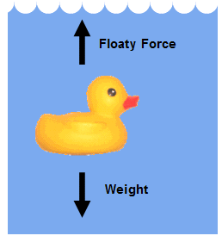
UNIT II-5: FLUIDS
Cartesian diver lab

Slide 3
Cartesian diver lab
Observe the model Cartesian diver
Use the materials provided to make your own, functioning Cartesian diver
Have your diver checked by the teacher before the end of the period
Write a brief lab report including the following:
Title
Purpose
Materials list
Labeled diagram of your diver
Explanation of how the diver works including the appropriate law, principle, theory or theorem(s). This should be a minimum of 2 paragraphs.
Application: think of at least 2 places where this phenomena can be used
Clean up your mess! You will lose points if I have to clean up after you!
Extra credit: build a diver that can sink, retrieve an object and return to the surface

