Slide 1
ANNOUNCEMENTS
Coffee filter drag lab due tomorrow
FR Work day tomorrow- be sure you’ve attempted 1-6
Ch 6 quiz and HW due next Wed 9/23
UTED research day next Friday 9/25
Newton’s Laws/Dynamics EXAM Mon9/28
Field trip forms?????

Slide 2
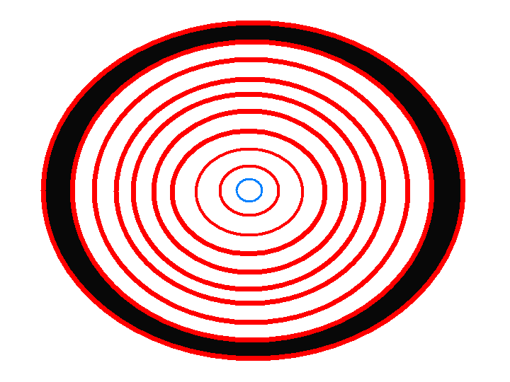
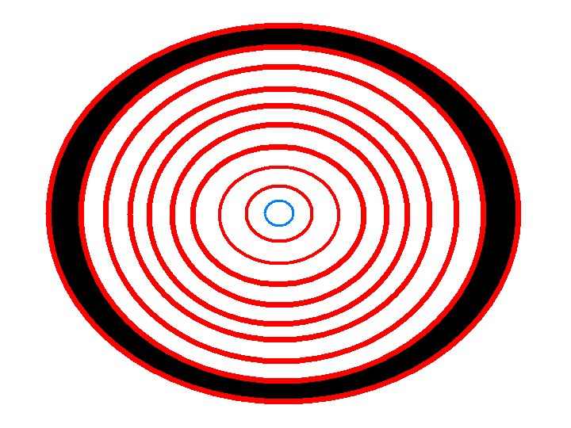
Centripetal Force

Slide 3
Centripetal forces are forces that cause centripetal acceleration
Many types of forces, including gravity, friction, tension, electromagnetic, and normal forces, can act centripetally.
Mathematical analysis:

Slide 4
Highway Curves
z
R
Friction turns the vehicle
r
Normal force turns the vehicle

Slide 5
Problem: Find the minimum safe turning radius for a car traveling at 60 mph on a flat roadway, assuming a coefficient of static friction of 0.70.

Slide 6
Problem: Derive the expression for the best banking angle of a roadway given the radius of curvature and the likely speed of the vehicles.

Slide 7
Conical Pendulum
z
What provides the centripetal force for a conical pendulum?
L
T
r
mg

Slide 8
Problem: Derive the expression for the period of a conical pendulum with respect to the string length and radius of rotation.

