Slide 1
ANNOUNCEMENTS:
NEXT WEEK: PROJECT OCTOBER SKY!
Outside on Tuesday and Friday
Ch 8 HW Quiz and HW due- Tuesday 11/3
Energy Exam Thursday 11/12

Slide 2
Conservation of Energy
Lesson 5

Slide 3
What does a system look like?

Slide 4
Law of Conservation of Energy
The system is isolated

Slide 5
Pendulum Energy

Slide 6
Spring Energy
0
m
m
m

Slide 7
Problem: A single conservative force of F = (3i + 5j) N acts on a 4.0 kg particle. Calculate the work done if the particle if the moves from the origin to r = (2i - 3j) m. Does the result depend on path?
What is the speed of the particle at r if the speed at the origin was 4.0 m/s?
What is the change in potential energy of the system?

Slide 8
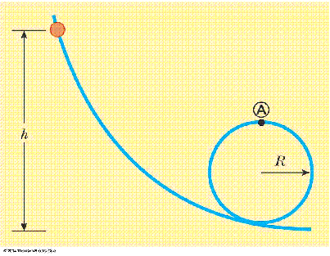
Sample Problem: A bead slides on the loop-the-loop shown. If it is released from height h = 3.5 R, what is the speed at point A? How great is the normal force at A if the mass is 5.0 g?

