Slide 1
Announcements
Selfie + Book Number (check ✓)
Lab fees?
Ch 2 HW Quiz Friday
Ch 2 HW Due Monday 8/17

Slide 2
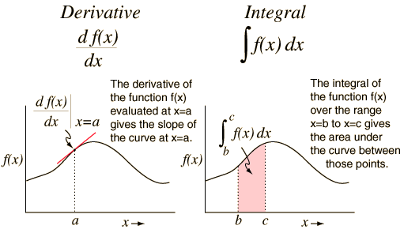
Lesson 6
Derivative and Integral Graphical Laboratory

Slide 3
Derivative and Integral Graphical Laboratory
Purpose: to analyze x-vs-t and v-vs-t graphs for an accelerating object and clearly show:
how instantaneous velocities derived from x-vs-t graph correlate to velocity values on the corresponding v-vs-t graph.
how areas under the curve of the v-vs-t graph correlate to displacements obtained from the corresponding x-vs-t graph.
General Method: Use a motion sensor to collect data for an object that is not accelerating uniformly. Print out, for each person in your group, the appropriate x-vs-t and v-vs-t graphs. These graphs should clearly show an appropriate tangent lines on the x-vs-t graph and an appropriate area on the v-vs-t graph.
Report: Your lab report will focus on the analysis of your graphs as defined above. Each person in the group can use the same set of two graphs, but must analyze the graphs independently and produce an independent lab report. It is permitted to write on your graph printout as part of your analysis

