Slide 1
ANNOUNCEMENTS:
Capacitance Derivation Quiz Friday
Ch 25 HW Quiz and HW due Thursday 2/11
Electrostatics Exam Mon-Tues 2/15-16
Testing/scheduling struggles!

Slide 2
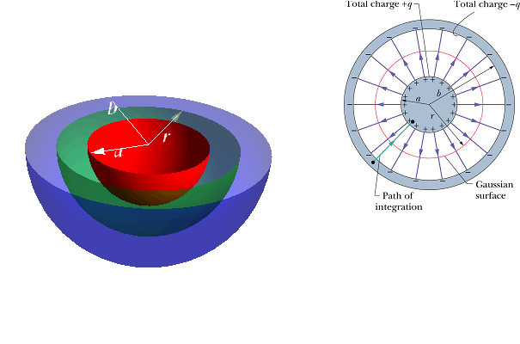
Deriving Capacitance using Gauss’s Law
Electrostatics Unit

Slide 3
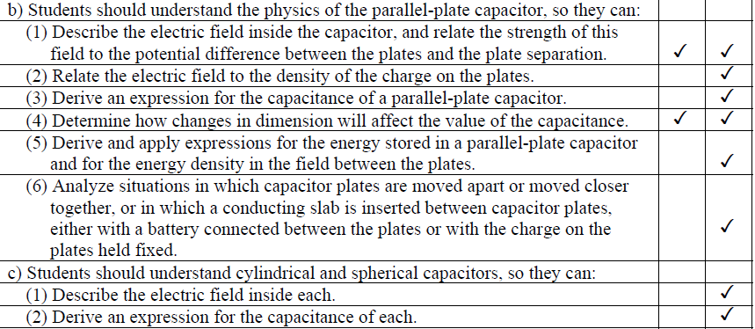
College Board Standards

Slide 4
Deriving Capacitance -- Steps
Draw the capacitor; identify its symmetry
Draw Gaussian surface. You must have constant or zero electric field on all parts of the surface, and all or part of the surface must be between the capacitor plates.
Write Gauss’ Law.
Solve Gauss’ Law for E.
Develop function for ΔV from E.
Develop function for C from ΔV . C = q / ΔV

Slide 5
Derive C for Charged Sphere

Slide 6
Derive C for Parallel Plate Capacitor

Slide 7
Derive C for a Spherical Capacitor

Slide 8
Derive C for a Cylindrical Capacitor

