Slide 1
ANNOUNCEMENTS:
Ch 25 HW Quiz and HW due Thursday 2/11
Friday- review day/State Meet/NAIMUN
Electrostatics Exam Mon (MC) and Tues (FR) 2/15-16
Lab next Wed-Fri
Ch 26-27 HW Quiz and HW due Monday 3/8

Slide 2
Energy density:

Slide 3
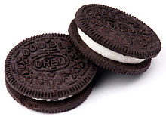
Dielectrics in capacitors
Electrostatics Unit

Slide 4
College Board Standards

Slide 5
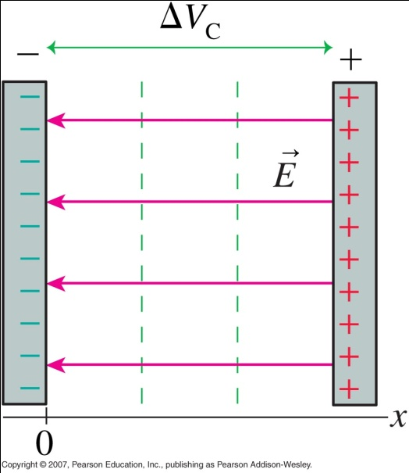
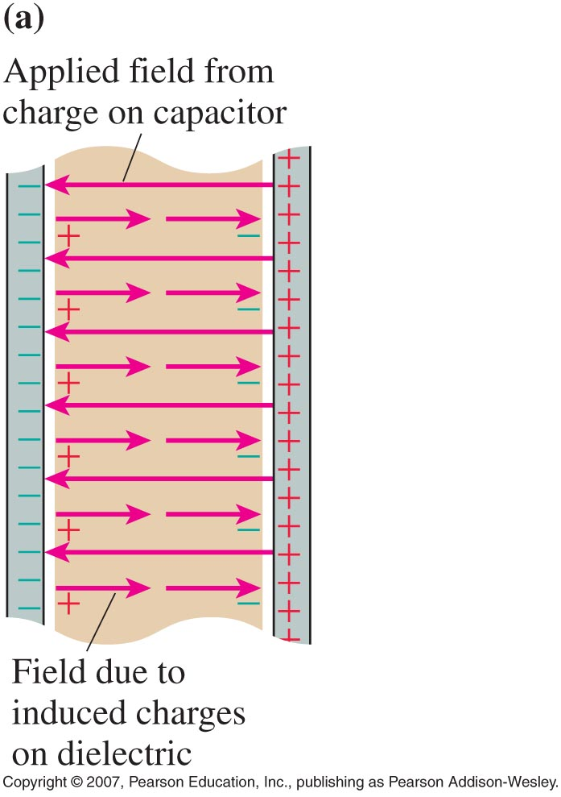
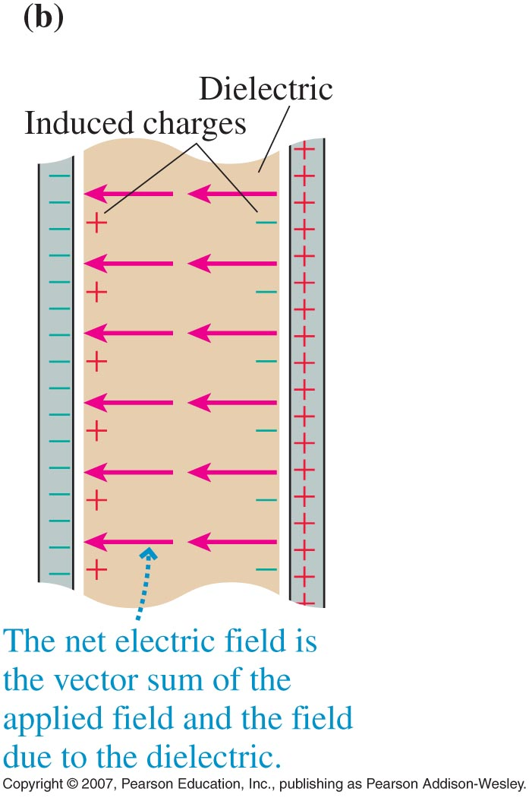
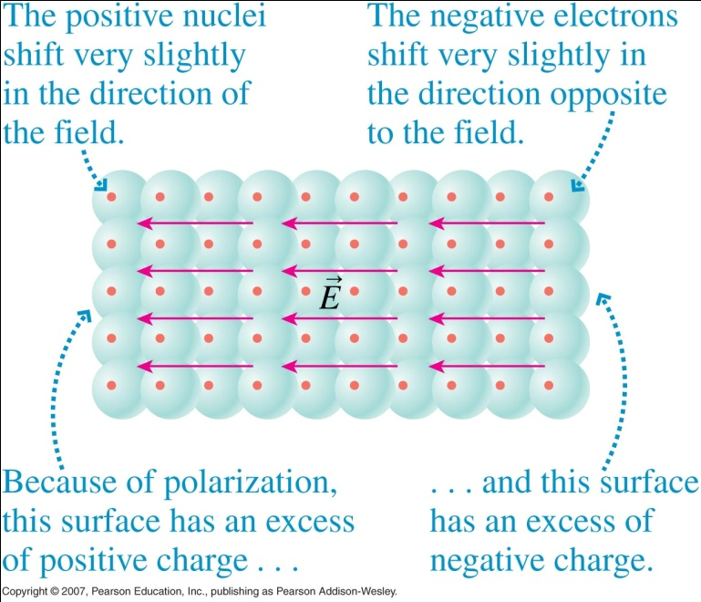
air core capacitor
dielectric filling

Slide 6
Dielectrics in Capacitors
Dielectrics are polar non-conductors that orient themselves such that their electric dipoles subtract from the field produced between charged plates.
The opposing field produced by the dielectric weakens the electric field between the plates. The voltage between the plates is reduced for a given charge separation.
Dielectrics can be characterized as to their effectiveness by their dielectric constant, κ.
C = κ C_{o}

Slide 7
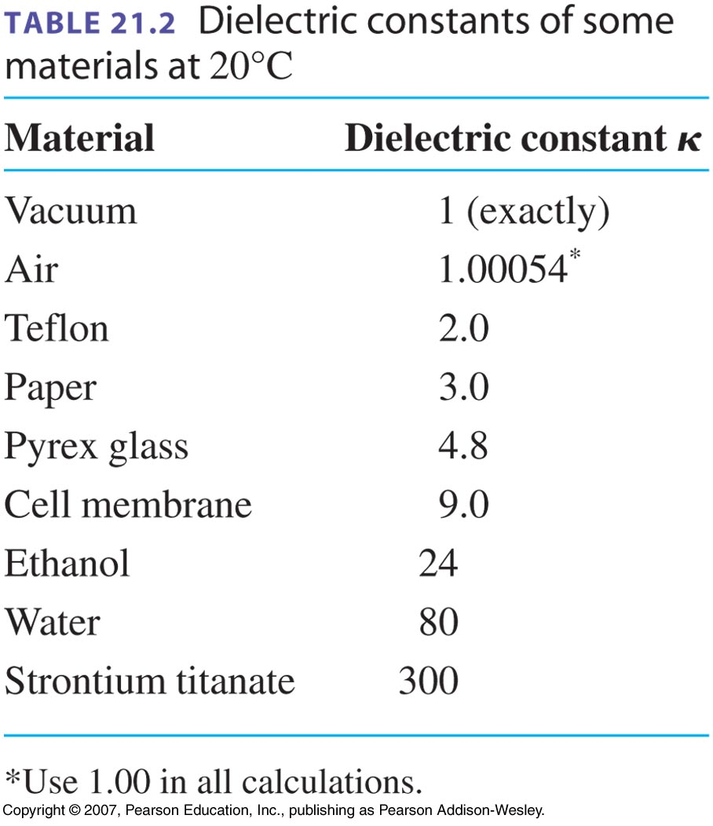

Slide 8
Sample Problem: Find the capacitance of a parallel plate capacitor that uses porcelain as a dielectric, if each of the plates has an area of 5.0 cm² and the plate separation is 2.00 mm. Porcelain has a dielectric constant of 6.5.

Slide 9
Sample Problem: Predict what will happen to the (a) capacitance, (b) charge, (c) electric field, (d) potential difference when a dielectric is inserted between the plates of a charged capacitor in the following two situations.
Capacitor remains connected to battery
Capacitor has been disconnected from battery

