Slide 1
ANNOUNCEMENTS:
Test Repair tomorrow 7:20 AM only
Friday: The Martian- Get a plan.
Ch 7 HW Quiz and HW due Tuesday 10/20
UTED Thursday 10/22

Slide 2
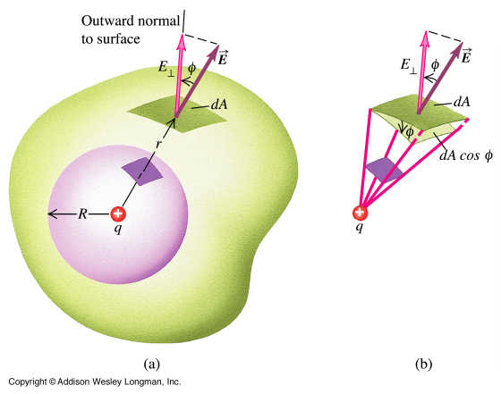
Work and Energy
Objective: To use the dot product to calculate work done by a specified constant force.

Slide 3
Work is a “Dot Product”

Slide 4
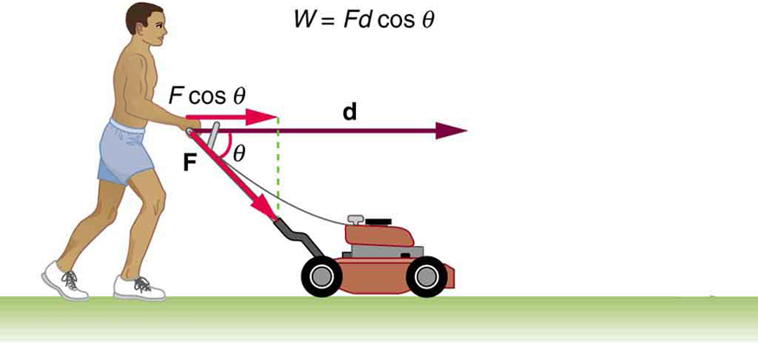
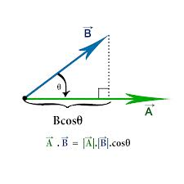
Work is a “Dot Product”

Slide 5
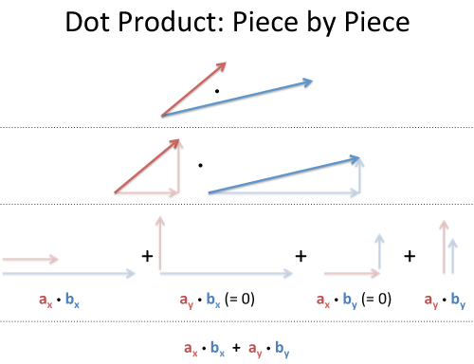
Work is a “Dot Product”

Slide 6
Work is a “Dot Product”
So forget the fancy math, what does the dot product really mean physically?

Slide 7
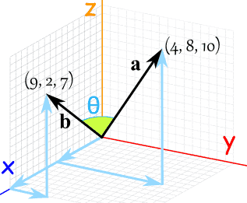
Work is a “Dot Product”
This works in multiple dimensions!

Slide 8
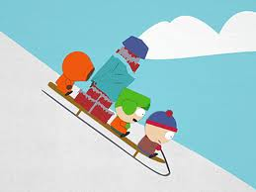
Problem: A sled loaded with bricks has a mass of 20.0 kg. It is pulled at constant speed by a rope inclined at 25º above the horizontal, and it moves a distance of 100 m on a horizontal surface. If the coefficient of kinetic friction between the sled and the ground is 0.40, calculate the work done by the rope on the sled

