Slide 1
ANNOUNCEMENTS:
Ch 8 HW Quiz and Ch 8 HW due Tomorrow
Rocket Labs due Friday 11/6 by 11:59 pm on Turnitin- DON’T WAIT ‘TIL THE LAST MINUTE!
Ch 9 HW Quiz and HW due Mon 11/9
Energy and Momentum EXAM Thursday- Friday 11/12-13

Slide 2
Force from Potential Energy
Lesson 9

Slide 3
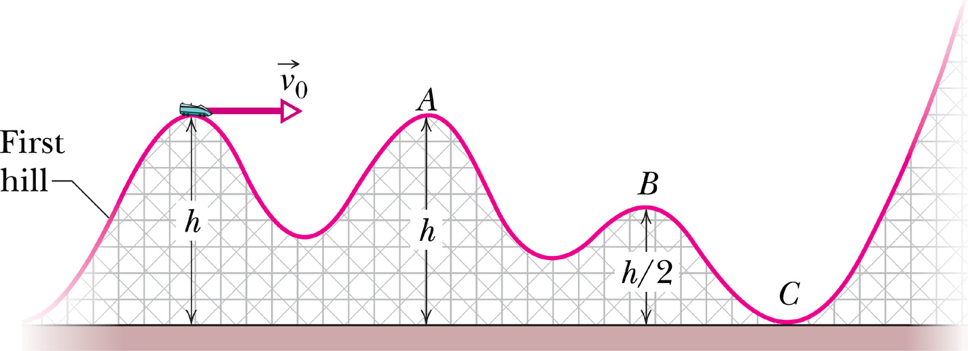
Force and Potential Energy: How do we get a force vector from a potential energy surface?

Slide 4
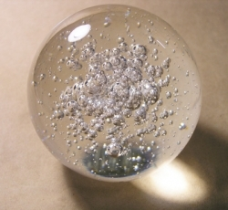
Neutral Equilibrium – 1st and 2nd Derivatives
U
x

Slide 5
Stable Equilibrium – 1st and 2nd Derivatives
U
x

Slide 6
Unstable Equilibrium – 1st and 2nd Derivatives
U
x

Slide 7
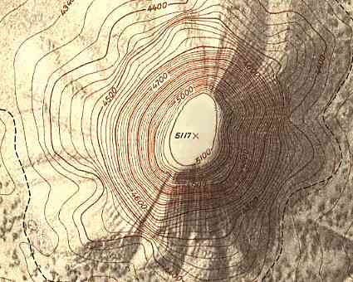
More on Potential Energy and Force

Slide 8
Molecular potential energy diagrams
U
R

Slide 9
Problem: The potential energy of a two-particle system separated by a distance r is given by U(r) = A/r, where A is a constant. Find the radial force F that each particle exerts on the other.

Slide 10
Problem: A potential energy function for a two-dimensional force is of the form U = 3x³y – 7x. Find the force acting at a point (x,y).

