Slide 1
Announcements
Phet lab due via turnitin tomorrow midnight
The Martian- sheets? Ch 1-2 by Monday
Ch 2 HW Quiz Friday (make up? Lunch Monday)
Ch 2 HW Due Monday
Derivative and Integral Lab due 8/17

Slide 2
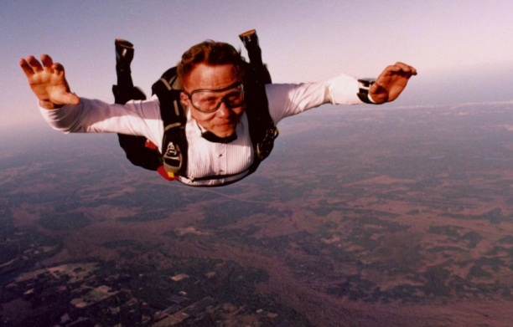
Freefall

Slide 3
Free Fall
an object falls solely under the influence of gravity
the object accelerates toward the earth the entire time it is in the air
resistive forces are ignored

Slide 4
Freefall Mini-Lab
Use the Spark/Motion Sensor set up to investigate the motion of a ball and another object while falling.
Turn in a graph for each along with your conclusions/calculations.
One per group by the end of the period.

