Slide 1
ANNOUNCEMENTS
Newton’s 2nd Law lab due tomorrow
Newton’s Laws Free Response packet begins today- 9 problems!
Newton’s Laws pretest 9/24
Newton’s Laws Exam 9/28
FIELD TRIPS!!!!!!
Permission Slips
The Martian: 10/2, $5.50
UT Engineer’s Day: 10/22, $5.00
Research Day: 9/25

Slide 2
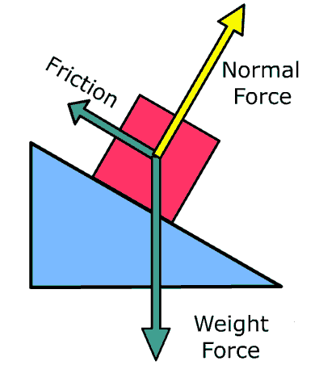
Friction Lab
OBJ: Analyze motion of object on rough incline plane or horizontal surface
OBJ: Analyze motion of object on rough incline plane or horizontal surface.

Slide 3
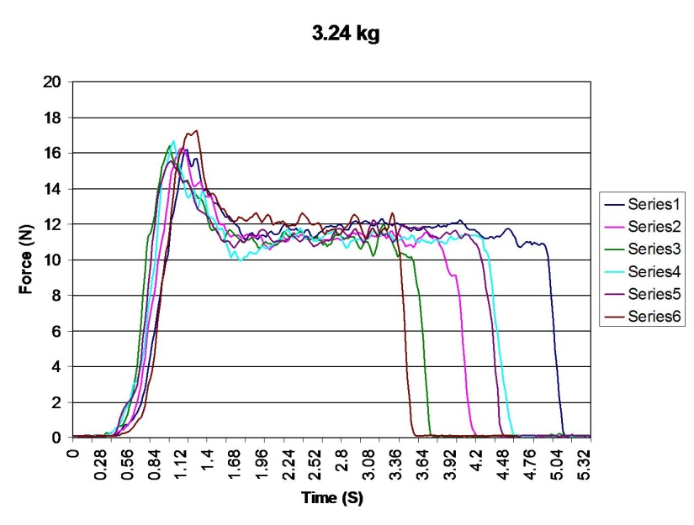
Friction Lab
Using a Spark, a force probe, and an object you choose to push across the floor or desk, design an experiment to calculate the coefficients of static and kinetic friction between the two surfaces. You must print out one copy of your graphical force data. As a lab group, perform the appropriate analysis and submit on Monday 9/15.
Lab groups today will consist of
Manager
Reporter
Technician

Slide 4
Report (on Graph) Will Contain:
Coefficient of static friction and a clear indication of how it was calculated.
Coefficient of kinetic friction and a clear indication of how it was calculated.
Answers to the following questions:
How does static friction compare in magnitude to the applied force?
How does kinetic friction compare in magnitude to the applied force?
When a car stops normally without skidding, why is static friction involved and not kinetic friction? After all, isn’t the car moving?

