Slide 1
ANNOUNCEMENTS:
Atwood Lab- due today by 11:59 pm
Newton’s 2nd Law Lab- due Thursday by 11:59 pm
Friction Lab Wednesday and Thursday.

Slide 2
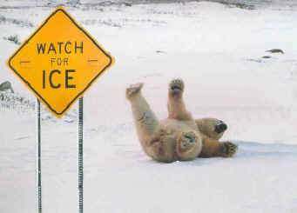
Friction Review
Lesson 9

Slide 3
Friction
Friction opposes a sliding motion.
Static friction exists before sliding occurs
(f_{s} ≤ μ_{s}N).
Kinetic friction exists after sliding occurs
f_{k} = μ_{k}N
OBJ: Analyze motion of object on rough incline plane or horizontal surface.

Slide 4
OBJ: Analyze motion of object on rough incline plane or horizontal surface.
y
y
x
x
Draw a free body diagram for a braking car.
Draw a free body diagram for a car accelerating from rest.

Slide 5
Draw free body diagrams that include friction for a body which is
θ
θ
Sliding down a ramp
Sliding up a ramp
OBJ: Analyze motion of object on rough incline plane or horizontal surface.

Slide 6
Sample problem: A 1.00 kg book is held against a wall by pressing it against the wall with a force of 50.00 N. What must be the minimum coefficient of friction between the book and the wall, such that the book does not slide down the wall?
F
OBJ: Analyze motion of object on rough incline plane or horizontal surface.

Slide 7
Problem: Assume a coefficient of static friction of 1.0 between tires and road. What is the minimum length of time it would take to accelerate a car from 0 to 60 mph?
OBJ: Analyze motion of object on rough incline plane or horizontal surface.

Slide 8
Problem: Assume a coefficient of static friction of 1.0 between tires and road and a coefficient of kinetic friction of 0.80 between tires and road. How far would a car travel down a 15º incline after the driver applies the brakes if it skids to a stop? Assume the speed before brakes are applied is 26 m/s.
OBJ: Analyze motion of object on rough incline plane or horizontal surface.

