Slide 1
Gen Phys
Notebook and Pen/Pencil
Leave ALL other materials in the cubbies in front of your desk.
Ch 2 Test Tuesday 9/15- one week from today!

Slide 2
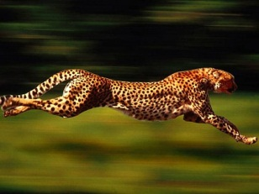
Distance, Displacement, Speed, and Velocity
Chapter 2:

Slide 3
Average Velocity from P-T Graphs Lab
Objective: Students will be able to calculate average velocity of a constant velocity car from a position-time graph.
Materials:
constant velocity car
100m tape measure
10 timers
Graph paper

Slide 4
Procedure:

Slide 5
Procedure
10 m of the tape measure will be laid out in the hallway in front of the classroom.
At every 1 m, a student will stand with a timer.
A constant velocity car will be placed at the 0 m mark.
The moment the car is set in motion, all the timers will start and as the car passes your timer, you will stop the timer.
The classes data will be recorded, graphed, and a line of best fit will be drawn in on the position-time graph.
Repeat steps 3-5 for a car running on 1 battery.

Slide 6
Lab Roles:

Slide 7
Data table

Slide 8
Data Table
Position (m) | Time of Slow Car (s) | Time of Fast Car (s)

Slide 9
Average Lab cont.
Lab Analysis: Find the average velocity of each car (in m/s) using the slope of the line of best fit. Show your work.
$$m= \frac{y_{2}− y_{1}}{x_{2}− x_{1}}$$

