Slide 1
Gen Phys
Today you need:
Notebook
Pen/Pencil
Colored pencils (2)
Data sheet (from Fri)
graph paper (from Fri)
calculator
Leave ALL other materials in the cubbies.
Ch 2 Test Tuesday 9/15 TOMORROW!!!!!

Slide 2
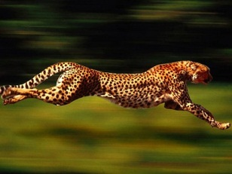
Distance, Displacement, Speed, and Velocity
Chapter 2:

Slide 3
Average Velocity from P-T Graphs Lab
Objective: Students will be able to calculate average velocity of a constant velocity car from a position-time graph.
Materials:
constant velocity car
100m tape measure
10 timers
Graph paper

Slide 4
Procedure:

Slide 5
Procedure
10 m of the tape measure will be laid out in the hallway in front of the classroom.
At every 1 m, a student will stand with a timer.
A constant velocity car will be placed at the 0 m mark.
The moment the car is set in motion, all the timers will start and as the car passes your timer, you will stop the timer.
The classes data will be recorded, graphed, and a line of best fit will be drawn in on the position-time graph.
Repeat steps 3-5 for a car running on 1 battery.

Slide 6
Lab Roles:

Slide 7
Data table

Slide 8
How to take an average:

Slide 9
Data Table
Position (m) | Time of Slow Car (s) | Time of Fast Car (s)

Slide 10
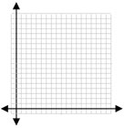
Graph the Data:

Slide 11
Average Lab cont.
Lab Analysis: Find the average velocity of each car (in m/s) using the slope of the line of best fit. Show your work.
$$m= \frac{y_{2}− y_{1}}{x_{2}− x_{1}}$$

