Slide 1
Announcements:
Motor/Generator Lab due 2/23
Unit II-3 Exam Friday 2/26
AP Exam(s): 75 DAYS!

Slide 2
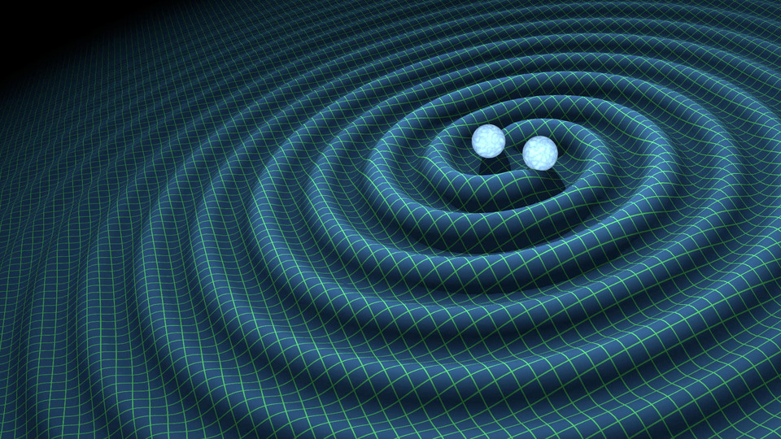
Current Event: Gravitational Waves

Slide 3
Background 1

Slide 4
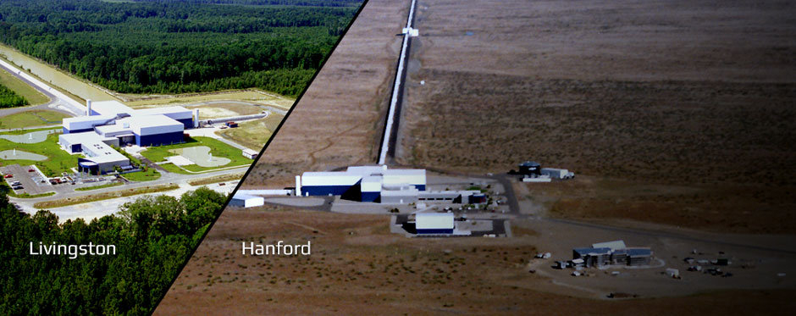
New Findings

Slide 5
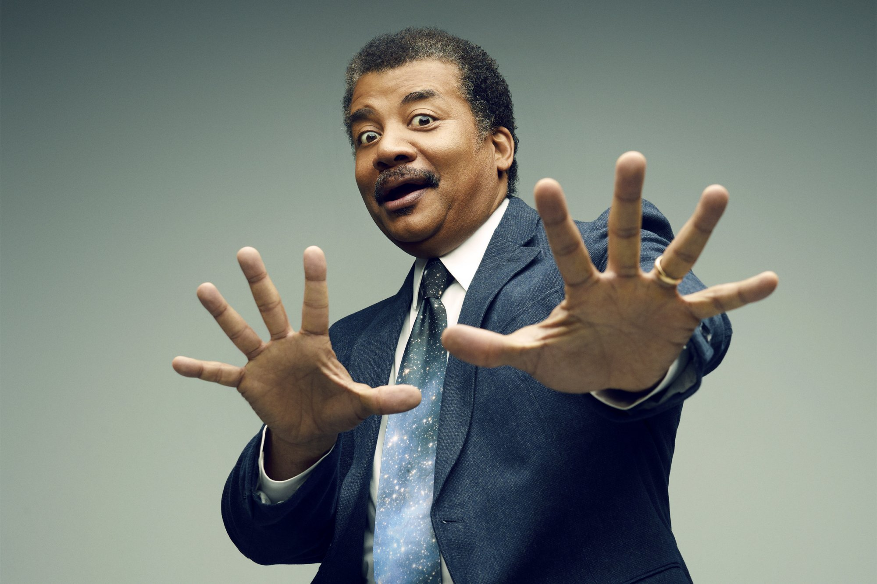
Neil Explains It All

Slide 6
Now You……….
Write a brief (2-3 paragraph) explanation of what gravity waves are, how they have been detected and what implications this development has for future studies.

