Slide 1
ANNOUNCEMENTS:
Tomorrow: AMC 12 (most)
Capacitance derivation quiz 2/5
Ch 25 HW Quiz and HW due Thursday 2/11
Electrostatics Exam 2/14-15

Slide 2
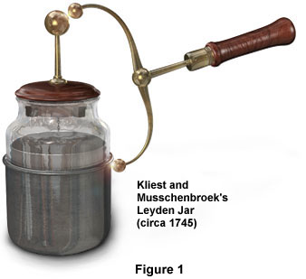
Defining and Calculating Capacitance
Electrostatics Unit

Slide 3
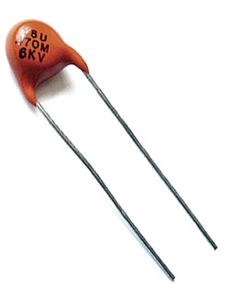
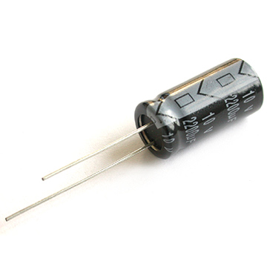
College Board Standards

Slide 4
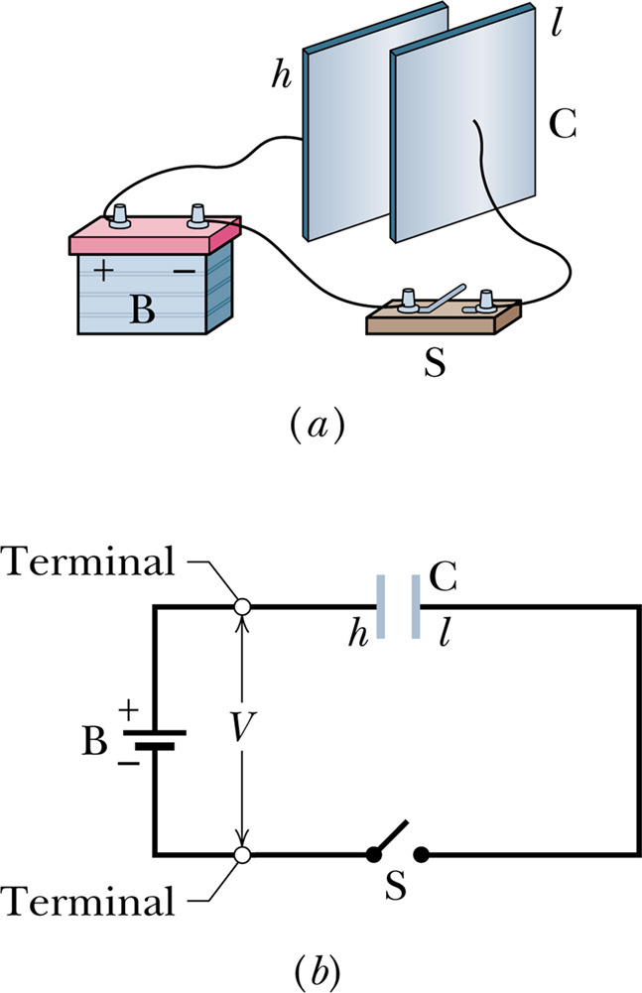
What is a Capacitor?
A capacitor
is a device designed to store electrical energy
consists of two conducting “plates” in close proximity
can be “charged” by applying a voltage across the plates so they bear equal and opposite charges

Slide 5
Parallel Plate Capacitor
+Q
V₁
V₂
dielectric
E
V₃
V₄
V₅
-Q

Slide 6
Cylindrical Capacitor
-Q
+Q

Slide 7
Capacitance

Slide 8
Sample Problem: These two objects have net charges of +70 pC and -70 pC, which result in a 20 V potential difference between them. What is the capacitance? Will it change if the amount of charge is increased or decreased?

Slide 9
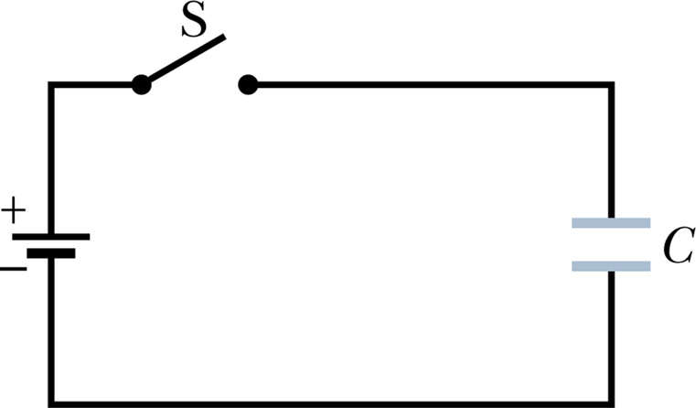
Sample Problem: The 25 mF capacitor in the figure is initially uncharged. If the battery provides 120 V, how much charge will pass through it after the switch is closed?

