Slide 1
Announcements
Selfie + Book Number
Lab fees?
Ch 2 HW Quiz Friday
Ch 2 HW Due Monday 8/17

Slide 2
Lesson 5
Kinematic Equation Review

Slide 3
Here are our old friends, the kinematic equations ☺

Slide 4
Sample problem (basic): Show how to derive the 1st kinematic equation from the 2nd.
Sample problem (advanced): Given a constant acceleration of a, derive the first two kinematic equations.

Slide 5
Sample problem: A body moving with uniform acceleration has a velocity of 12.0 cm/s in the positive x direction when its x coordinate is 3.0 cm. If the x coordinate 2.00 s later is -5.00 cm, what is the magnitude of the acceleration?

Slide 6
Sample problem: A jet plane lands with a speed of 100 m/s and can accelerate at a maximum rate of -5.00 m/s² as it comes to a halt. Can this plane land at a small tropical island airport where the runway is 0.800 km long?

Slide 7
Freefall

Slide 8
Free Fall
an object falls solely under the influence of gravity
the object accelerates toward the earth the entire time it is in the air
resistive forces are ignored

Slide 9
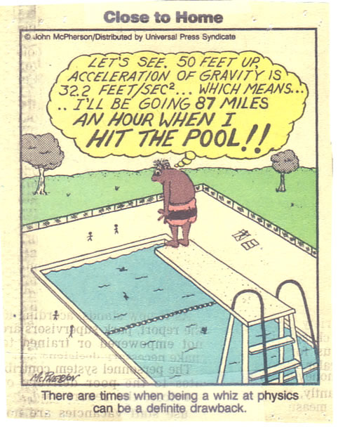
Is the calculation correct? Prove or disprove with a calculation.

Slide 10
Sample problem: A student tosses her keys vertically to a friend in a window 4.0 m above. The keys are caught 1.50 seconds later. a) With what initial velocity were the keys tossed? b) What was the velocity of the keys just before they were caught?

Slide 11
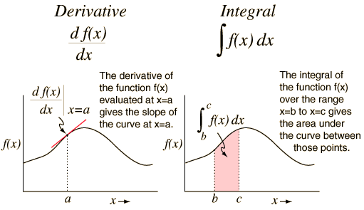
Lesson 6
Derivative and Integral Graphical Laboratory

Slide 12
Derivative and Integral Graphical Laboratory
Purpose: to analyze x-vs-t and v-vs-t graphs for an accelerating object and clearly show:
how instantaneous velocities derived from x-vs-t graph correlate to velocity values on the corresponding v-vs-t graph.
how areas under the curve of the v-vs-t graph correlate to displacements obtained from the corresponding x-vs-t graph.
General Method: Use a motion sensor to collect data for an object that is not accelerating uniformly. Print out, for each person in your group, the appropriate x-vs-t and v-vs-t graphs. These graphs should clearly show an appropriate tangent lines on the x-vs-t graph and an appropriate area on the v-vs-t graph.
Report: Your lab report will focus on the analysis of your graphs as defined above. Each person in the group can use the same set of two graphs, but must analyze the graphs independently and produce an independent lab report. It is permitted to write on your graph printout as part of your analysis

