Slide 1
ANNOUNCEMENTS:
FR Problems for HW- Don’t get behind!
Ch 6 HW Quiz, HW due Wednesday, 9/23
Newton’s Laws/Dynamics Exam Monday 9/28
Permission Slips!

Slide 2
Non-Constant Forces Part 1 Forces that vary with time
Objective: Calculate, for an object moving in one dimension, the velocity change that results when a force F(t) acts over a specified time interval.

Slide 3
What we know already
We know how to go from position to velocity if position is a function of time.
We know how to go from velocity to acceleration if velocity is a function of time.
Objective: Calculate, for an object moving in one dimension, the velocity change that results when a force F(t) acts over a specified time interval.

Slide 4
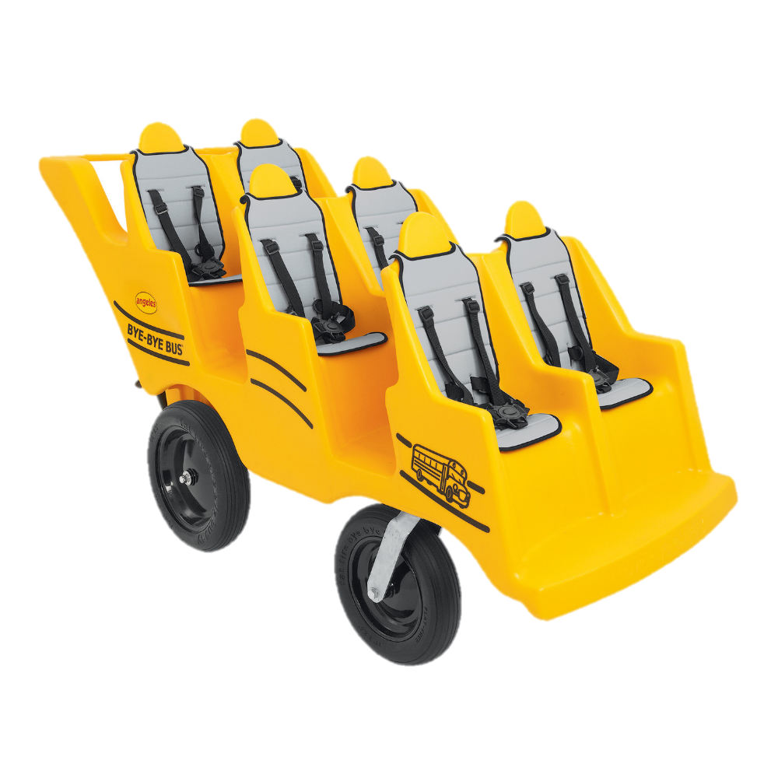
What we need to Learn Now
We need to learn how to go from acceleration to velocity if acceleration is a function of time.
We need to learn how to go from velocity to displacement if velocity is a function of time.
Put on your seatbelt, we’re in for an exciting ride!
Objective: Calculate, for an object moving in one dimension, the velocity change that results when a force F(t) acts over a specified time interval.

Slide 5
The problem
A 4-kg object traveling at 20 i m/s experiences a single force F(t)=20t² i N for 3 seconds. What is the resulting velocity?
Objective: Calculate, for an object moving in one dimension, the velocity change that results when a force F(t) acts over a specified time interval.

Slide 6
Step 1
Use Newton’s Second Law to develop a function for a.
Objective: Calculate, for an object moving in one dimension, the velocity change that results when a force F(t) acts over a specified time interval.

Slide 7
Step 2
Substitute dv/dt in place of a.
Objective: Calculate, for an object moving in one dimension, the velocity change that results when a force F(t) acts over a specified time interval.

Slide 8
Step 3
Separate variables
Objective: Calculate, for an object moving in one dimension, the velocity change that results when a force F(t) acts over a specified time interval.

Slide 9
Step 4
Indicate you will be summing all of the small dv values up to get the overall change in velocity.
Objective: Calculate, for an object moving in one dimension, the velocity change that results when a force F(t) acts over a specified time interval.

Slide 10
Step 5
Indicate the upper and lower limits of your time and velocity values

Slide 11
Step 6
Perform “anti-differentiation”.
Objective: Calculate, for an object moving in one dimension, the velocity change that results when a force F(t) acts over a specified time interval.

Slide 12
Formulas for Polynomial Functions
Derivative Anti-derivative
Objective: Calculate, for an object moving in one dimension, the velocity change that results when a force F(t) acts over a specified time interval.

Slide 13
Step 7
Evaluate your equation at the upper and lower limits. You always subtract the function evaluated at the lower limit from the function evaluated at the upper limit.
Objective: Calculate, for an object moving in one dimension, the velocity change that results when a force F(t) acts over a specified time interval.

Slide 14
Step 8
Solve for the velocity
Objective: Calculate, for an object moving in one dimension, the velocity change that results when a force F(t) acts over a specified time interval.

Slide 15
Sample problem: The velocity of an object follows the function v(t) = [2.0t – 3] m/s. If the object starts at x = 2 m, what is its position after 3 seconds?

Slide 16
Sample problem: Consider a force that is a function of time:
F(t) = (3.0 t – 0.5 t²) N
If this force acts upon a 0.2 kg particle at rest for 3.0 seconds, what is the resulting velocity and position of the particle?

Slide 17
Sample Problem: Displacement
v (m/s)
1.0
t (s)
-1.0
1.0
2.0
3.0
4.0
Consider the graph of velocity versus time shown above. Determine, first from an equation and then directly from the graph, the displacement from 0 to 1.0 s.

