Slide 1
ANNOUNCEMENTS:
Keep up with Mechanics Review!
Ch 28-29 HW Quiz and HW due 4/8
9 HW assignments
Includes FR #1-7 (from Magnetism packet)
Mechanics MC Review due 4/11
Mechanics FR Review due 4/18
LR Circuit Derivation Quiz 4/22
Mechanics Mock AP 4/26-27
Magnetism Exam 4/28-29

Slide 2
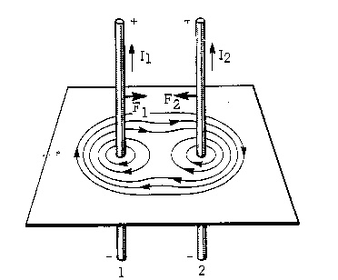
Parallel Currents
Calculating the magnetic field

Slide 3
College Board Objectives

Slide 4
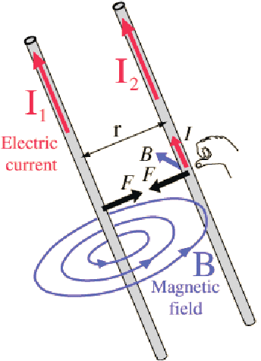
Force between two parallel currents
Current in a wire produces a magnetic field (1)
The magnetic field, B, exerts a force on charged particles (2)
3rd: Equal and opposite forces- We’ll see it in the equation
The basis for the Ampere:
The ampere is the constant current which, if maintained, in two straight, parallel conductors of infinite length, of negligible circular cross section, and placed 1 m apart in a vacuum, would produce on each of these conductors a force of magnitude 2 x 10⁻⁷ N/m.

Slide 5
Sample Problem: Two parallel wires have currents of I₁ and I₂ in exactly the same direction. Define the magnitude and direction of the force they exert on each other.

Slide 6
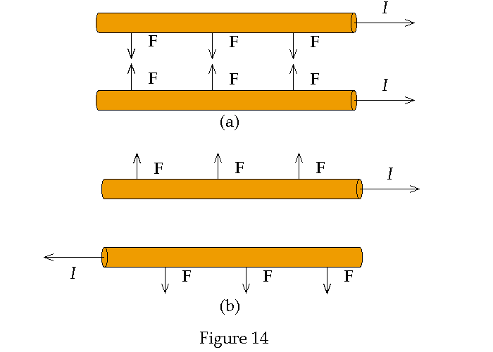
In General
Parallel currents attract each other.
Anti-parallel currents repel each other.

Slide 7
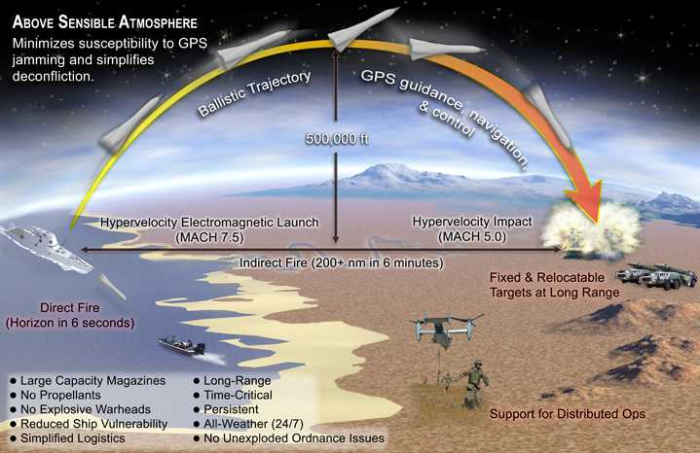
Interesting Application

Slide 8
Sample Problem: Two parallel wires have currents of 20 A in the +x direction and 10 A in the –x direction. The wires are 0.10 m apart. Determine where the magnetic field is zero.

Slide 9
Trig. Sub. Tutorial

