Slide 1
ANNOUNCEMENTS:
Biot-Savart Quiz Thurs 3/31
Mechanics MC Review coming Wednesday:
90 questions/25 pages.
Do a few each day.
Due 4/11
Mech FR, E&M MC and E&M FR coming soon
AAPT Physics Bowl Exam Thursday 4/7
Ch 28-29 Quiz & HW due (9 assignments) 4/8
Magnetism Exam 4/29
AP EXAM 5/9

Slide 2
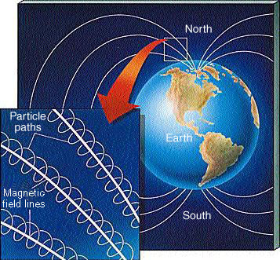
Path of Charged Particles in Magnetic Field

Slide 3
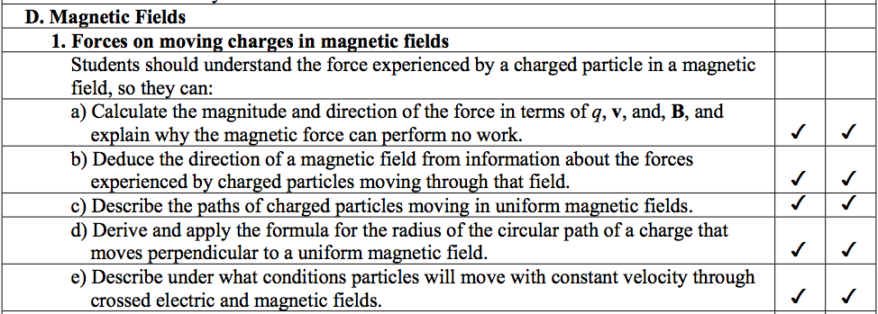
College Board Objectives

Slide 4
Sample Problem: A charge of mass m and charge q moves at speed v at right angles to magnetic field B as shown. Derive an expression for the path of the particle as a function of charge, mass, speed, and magnetic field strength.
V
+q
B

Slide 5
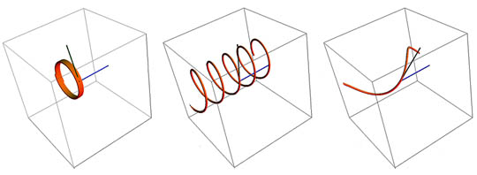
Paths of charged particles in magnetic field
Circle
When velocity is perpendicular to field
Helix
When velocity has a component parallel to the field
Straight
When velocity is entirely parallel to field

Slide 6
Magnetic Force
What can be concluded about the sign of the charge of each particle?
1
3
2

Slide 7
Magnetic Force
What can be concluded about the sign of the charge of each particle?
positive
neutral
1
3
negative
2

Slide 8
Crossed electric and magnetic fields can be “velocity filters”
B
v
p⁺
E

Slide 9
Do these work on negative particles too?
B
v
e⁻
E

Slide 10
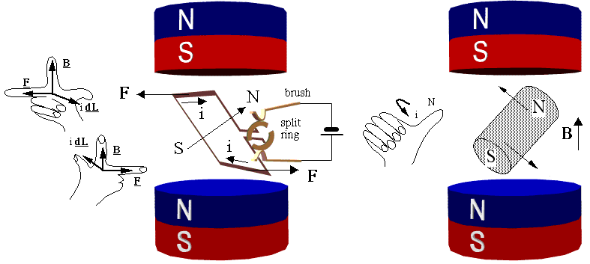
Magnetic force on current carrying wire

Slide 11
College Board Objectives

Slide 12
Magnetic Force on Current-carrying Wire
F = iL × B
i: current in Amps
L: length in meters (direction of current)
B: magnetic field in Tesla
Derive this expression!

Slide 13
F = iL x B

Slide 14
Sample Problem: A wire carries a current of 2.40 Amperes through a uniform magnetic field B=1.6 k Tesla. What is the force on a 0.75 meter long section of the wire if the current moves in the +x direction?

Slide 15
Sample problem: How much current must be flowing through a horizontal 20.0 meter long wire to suspended in a 5.0 T magnetic field if the wire has a mass of 0.20 kg?
If the current is flowing north, in what direction must be the magnetic field?

Slide 16
Torque on Wire Loop
a
B
i
i
b
i
i

Slide 17
Sample Problem: Calculate the torque on a 40.0 cm length of wire, bent into a square, if it carries 20.0 amperes of electrical current with its normal perpendicular to a magnetic field of strength 0.520 T.

