Slide 1
ANNOUNCEMENTS:
Ch 24 HW Quiz and HW due (4): Fri 1/29
AMC 12: Tues 2/2- most
Capicitance Quiz: 2/5 (band/orch? See me!)
Ch 25 HW Quiz and HW due (8): Thurs 2/11
Electrostatics Exam: 2/15-16

Slide 2
Electric Potential and Potential Energy due to Point Charges
Electrostatics Unit

Slide 3
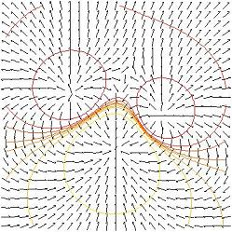
College Board Objective

Slide 4
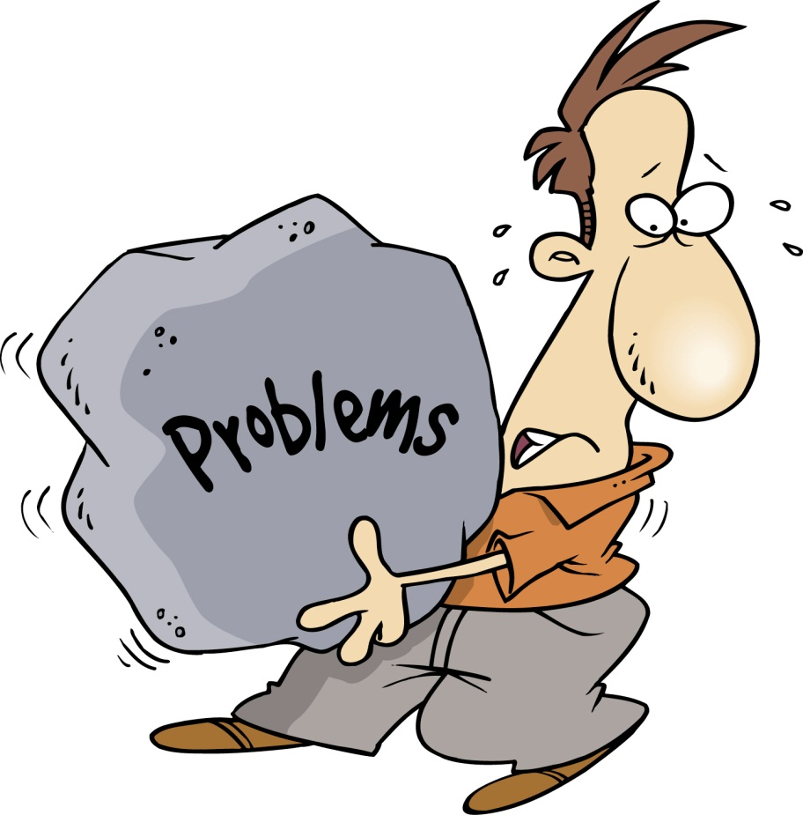
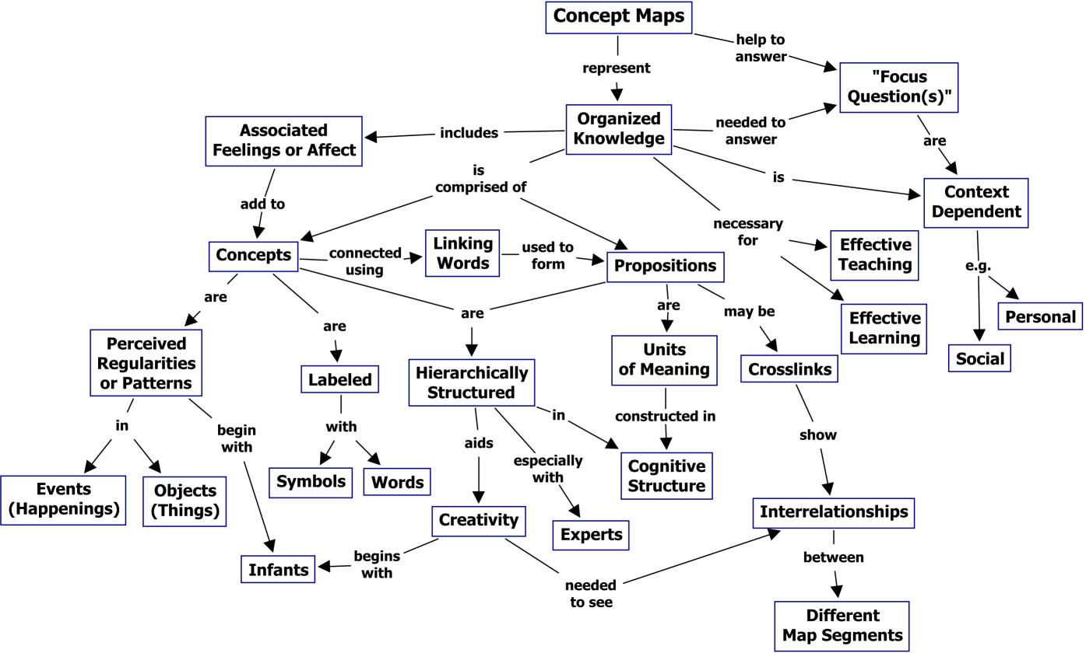
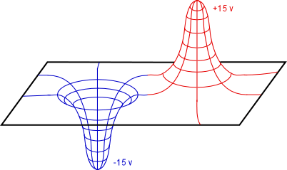
Lesson summary
Today we will look at electric potential and electric potential energy of point charges in terms of
Concepts
Graphs
Problems

Slide 5
Electric Potential of Point Charge

Slide 6
Potential Energy Graphs
U or V
Electric
(like charges)
r
Electric (unlike charges)
or Gravity

Slide 7
Sample Problem: Two point charges (5.0 nC and -3.0 nC) are separated by 35 cm. What is the potential energy of the pair? What is the electric potential at a point midway between the charges?

Slide 8
