Slide 1
ANNOUNCEMENTS:
Today: Power
Tomorrow: Ch 7 HW Quiz and Ch 7 HW due
Thursday: UTED!
2nd-8th Periods
‘Build Time’ lunch Mon-Wed
Next week: ROCKETS!

Slide 2
Power
Lesson 3

Slide 3
Power
Power is the rate of which work is done.
What are some equations we can use to calculate power? Come up with two per table.

Slide 4
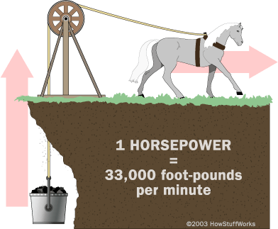
Units of Power
Watt = J/s
ft lb / s
horsepower
550 ft lb / s
746 Watts

Slide 5
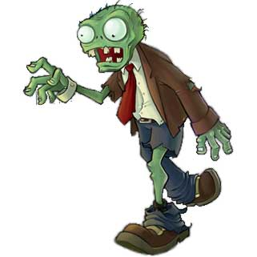
Problem: A 1000-kg space probe lifts straight upward off the planet Zombie, which is without an atmosphere, at a constant speed of 3.0 m/s. What is the power expended by the probe’s engines? The acceleration due to gravity of Zombie is ½ that of earth’s.

Slide 6
Problem: Develop an expression for the power output of an airplane cruising at constant speed v in level flight. Assume that the aerodynamic drag force is given by F_{D} = bv².
By what factor must the power be increased to increase airspeed by 25%?

Slide 7
Problem: Using what you know about units, calculate how many Joules is in a kilowatt-hour.

