Slide 1
ANNOUNCEMENTS:
Review Dynamics Exam today
Exam repair Thursday 7:20 AM ONLY
Friday field trip.
Make arrangements to miss
Pack a lunch
Bring an umbrella
UTED “next” Thursday

Slide 2
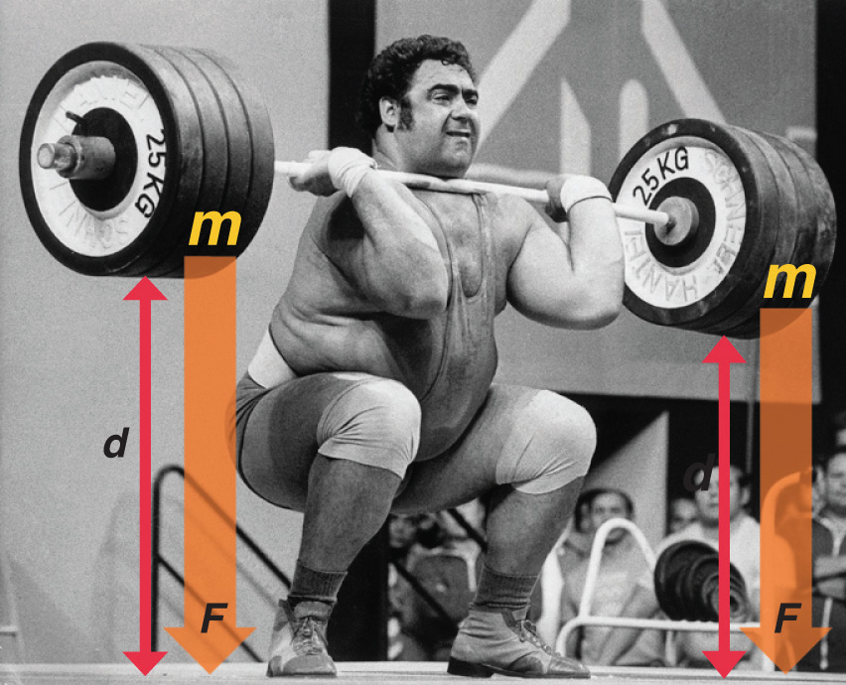
Work and Energy
Objective: To calculate work done by a specified constant force.

Slide 3
Why work?
Discuss with your lab table why you think the concept of physical work is important.
What exactly is work physically?
What does work do mathematically?
Objective: To calculate work done by a specified constant force.

Slide 4
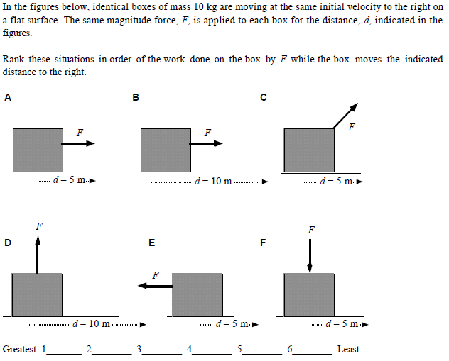
Calculating Work
Objective: To calculate work done by a specified constant force.

Slide 5
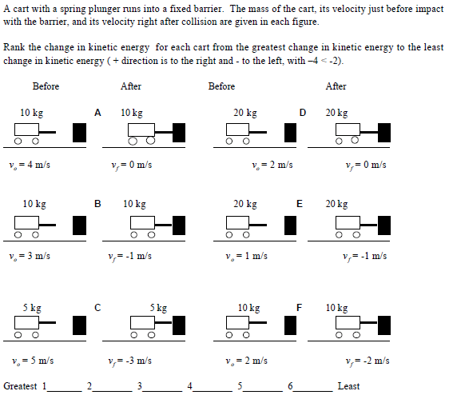
Calculating changes in Kinetic Energy
Objective: To calculate work done by a specified constant force.

Slide 6
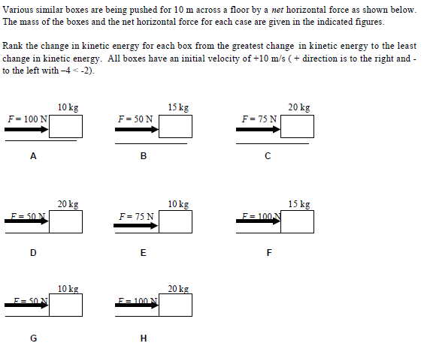
The Work-Energy Theorem
W_{net} = ΔK
Objective: To calculate work done by a specified constant force.

