Slide 1
Announcements
Punt, Pass and Kick Lab tomorrow- outside! Dress appropriately
Ch 3-4 HW Quiz Friday, HW due
Engineering Day? Thursday, 10/23

Slide 2
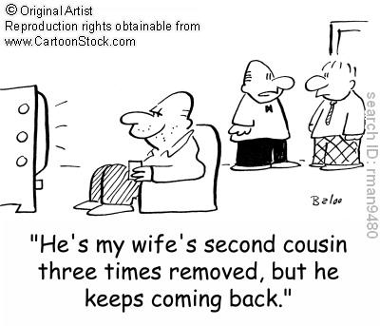
Relative Motion
Understanding Relative Motion

Slide 3
Will the projectile always hit the target presuming it has enough range? The target will begin to fall as soon as the projectile leaves the gun.

Slide 4
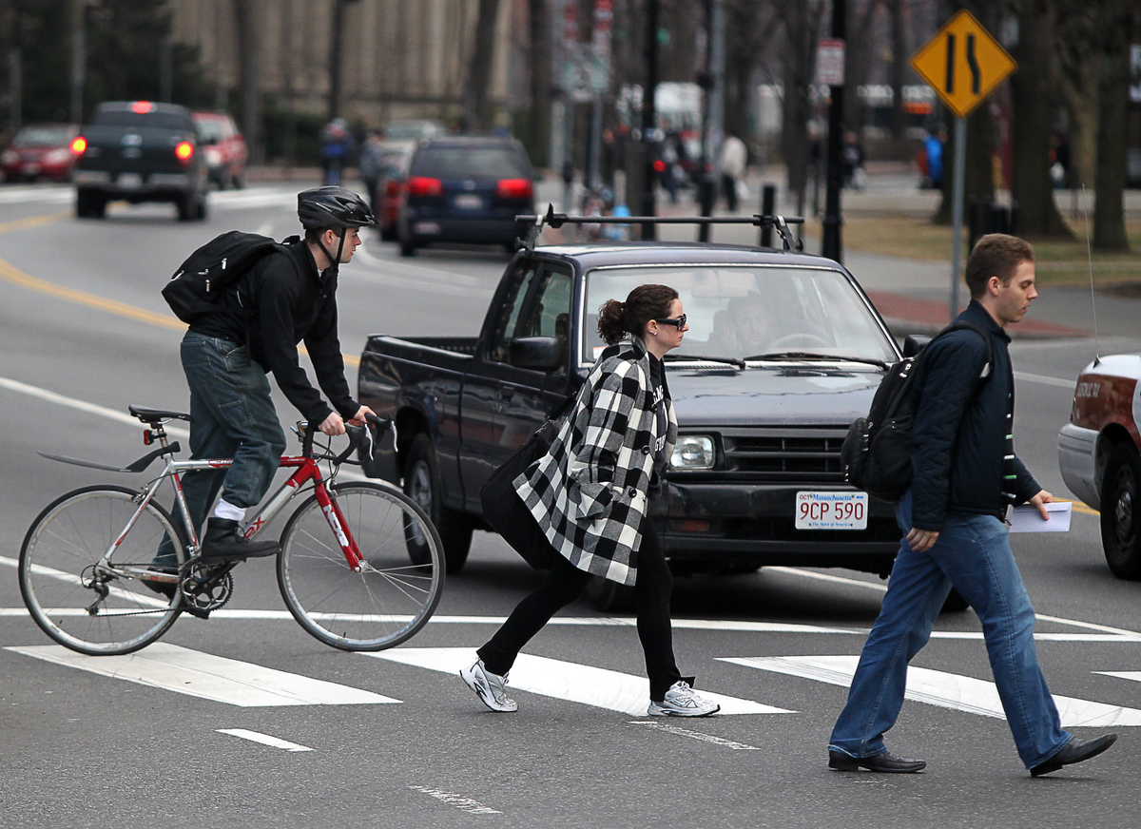
Consider this intersection…

Slide 5
Relative Motion
When observers are moving at constant velocity relative to each other, we have a case of relative motion.
The moving observers can agree about some things, but not about everything, regarding an object they are both observing.

Slide 6
Consider two observers and a particle. Suppose observer B is moving relative to observer A.
P
particle
v_{rel}
A
B
observer
observer

Slide 7
Also suppose particle P is also moving relative to observer A.
v_{A}
P
particle
In this case, it looks to A like P is moving to the right at twice the speed that B is moving in the same direction.
v_{rel}
A
B
observer
observer

Slide 8
However, from the perspective of observer B…
v_{B}
v_{A}
P
particle
it looks like P is moving to the right at the same speed that A is moving in the opposite direction, and this speed is half of what A reports for P.
-v_{rel}
v_{rel}
A
B
observer
observer

Slide 9
The velocity measured by two observers depends upon the observers’ velocity relative to each other.
v_{B}
v_{A}
P
particle
v_{B} = v_{A} – v_{rel}
v_{A} = v_{B} + v_{rel}
-v_{rel}
v_{rel}
A
B
observer
observer

Slide 10
Sample problem: Now show that although velocity of the observers is different, the acceleration they measure for a third particle is the same provided v_{rel} is constant. Begin with: v_{B} = v_{A} - v_{rel}

Slide 11
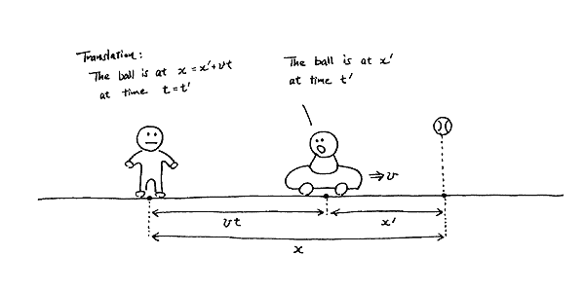
Galileo’s Law of Transformation of Velocities
If observers are moving but not accelerating relative to each other, they agree on a third object’s acceleration, but not its velocity!

Slide 12
Inertial Reference Frames
Frames of reference which may move relative to each other but in which observers find the same value for the acceleration of a third moving particle.
Inertial reference frames are moving at constant velocity relative to each other. It is impossible to identify which one may be at rest.
Newton’s Laws hold only in inertial reference frames, and do not hold in reference frames which are accelerating.

Slide 13
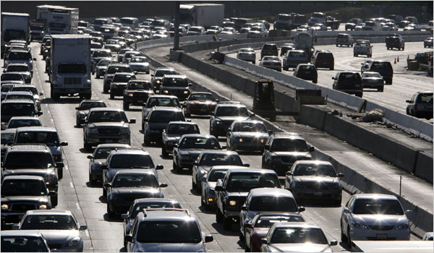
Sample problem: How long does it take an automobile traveling in the left lane at 60.0km/h to pull alongside a car traveling in the right lane at 40.0 km/h if the cars’ front bumpers are initially 100 m apart?

Slide 14
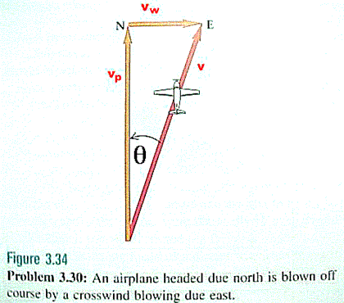
Sample problem: A pilot of an airplane notes that the compass indicates a heading due north. The airplane’s speed relative to the air is 150 km/h. If there is a wind of 30.0 km/h toward the east, find the velocity of the airplane relative to the ground.

