Slide 1
Physics Mock AP – E&M Exam
Tomorrow: FR work time- Score Mechanics or work on E&M (due Monday 5/2)
Monday E&M FR.
4/26-27 Mechanics Mock
4/28-29 Magnetism Exam
5/2 E&M MC packet due
5/2-5 E&M Mock
5/6 E&M FR Packet due

Slide 2
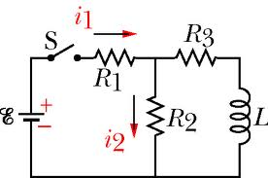
RL Circuits

Slide 3
Definition of an RL Circuit
A circuit with a resistance and an inductance is called an RL Circuit.
The inductor will oppose the change in the current through the circuit through self-inductance.
The RL circuit is similar to the RC circuit in the mathematics that it follows.

Slide 4
Inductive time constant, τ_{RL}
τ_{RL} is the inductive time constant of the RL circuit, and is the ratio L/R.
It is the point at which the circuit reaches 63% of its final current after a switch is closed and the current begins to flow.
It is the point at which the circuit loses all but 37% of its current after a switch is opened and the current ceases to flow.

Slide 5
RL Circuit – switch closed
L
ε_{L}
ε
R
V_{R}

Slide 6
RL Circuit – switch opened
L
ε
R

Slide 7
Graphs of RL Circuit – switch is just closed
i
t
V_{R}
V_{L}
t
t

Slide 8
Graphs of RL Circuit – switch is just opened
i
t
V_{R}
V_{L}
t
t

Slide 9
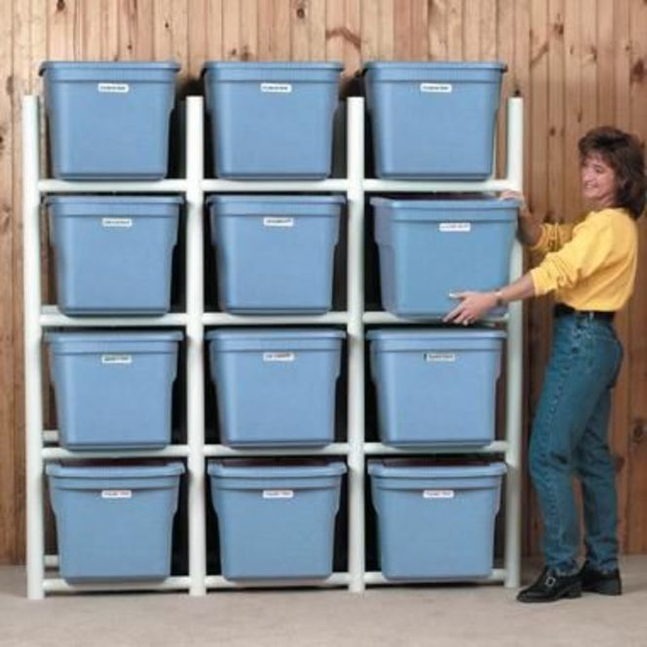
Energy stored in a Magnetic Field
U_{B} = ½ L I²
U_{B} : energy stored in magnetic field
L: inductance in Henrys
I: current in amperes

Slide 10
Sample problem: Calculate the energy associated with the magnetic field of a 200 turn solenoid in which a current of 1.75 A produces a flux of 3.7 x 10⁻⁴ T m².

