Slide 1
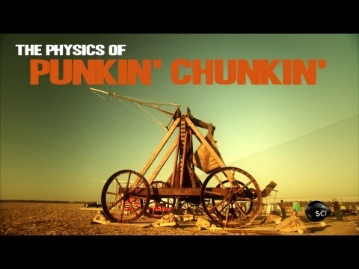
ANNOUNCEMENTS:
No school Wednesday-Friday (woo hoo!!!)
Ch 10 HW Quiz & HW Due Tues 12/1
Ch 11 HW Quiz & HW Due Thurs 12/10
Rotation Exam Tues 12/15
Generation Nano Challenge- info on board

Slide 2
Rotational Dynamics and Energetics

Slide 3
College Board Standards
E. Circular motion and rotation
3. Rotational kinematics and dynamics
c) Students should understand the dynamics of fixed-axis rotation, so they can:
(1) Describe in detail the analogy between fixed-axis rotation and straight-line translation.
(2) Determine the angular acceleration with which a rigid object is accelerated about a fixed axis when subjected to a specified external torque or force.
(3) Determine the radial and tangential acceleration of a point on a rigid object.
(4) Apply conservation of energy to problems of fixed-axis rotation.
(5) Analyze problems involving strings and massive pulleys.

Slide 4
College Board Standards
E. Circular motion and rotation
3. Rotational kinematics and dynamics
c) Students should understand the dynamics of fixed-axis rotation, so they can:
(1) Describe in detail the analogy between fixed-axis rotation and straight-line translation.
(2) Determine the angular acceleration with which a rigid object is accelerated about a fixed axis when subjected to a specified external torque or force.
(3) Determine the radial and tangential acceleration of a point on a rigid object.
(4) Apply conservation of energy to problems of fixed-axis rotation.
(5) Analyze problems involving strings and massive pulleys.

Slide 5
Practice problem
Calculate initial angular acceleration of rod of mass M and length L. Calculate initial acceleration of end of rod.
(2) Determine the angular acceleration with which a rigid object is accelerated about a fixed axis when subjected to a specified external torque or force.
(3) Determine the radial and tangential acceleration of a point on a rigid object.

Slide 6
Sample problem
Calculate acceleration, and tensions in strings. Assume pulley has mass M, radius R, and is a uniform disk.
m₂
Frictionless table
m₁
(5) Analyze problems involving strings and massive pulleys.

Slide 7
Practice problem
Calculate the angular speed of a rod of mass M and length L when it has rotated, under the influence of gravity, to the vertical position. Calculate the linear speed of the end of the rod.
(4) Apply conservation of energy to problems of fixed-axis rotation.

Slide 8
Derivation Quiz
Derive the rotational inertia of a solid disk given that the rotational inertia of a ring is MR².

