Slide 1
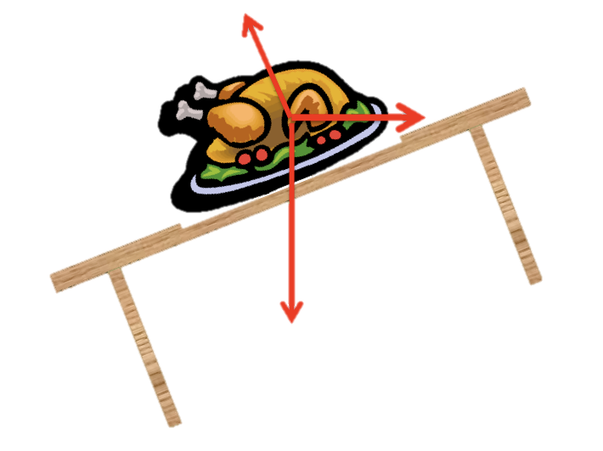
ANNOUNCEMENTS:
Test repair tomorrow morning
Next week: Thanksgiving! (Thank goodness!)
Ch 10 HW Quiz and HW Due 12/1
Ch 11 HW Quiz and HW due 12/10
Rotation Exam 12/15
Repair 12/17

Slide 2
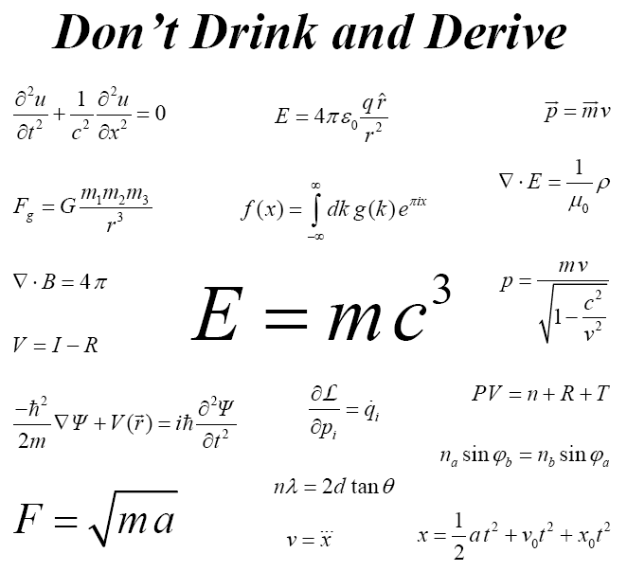
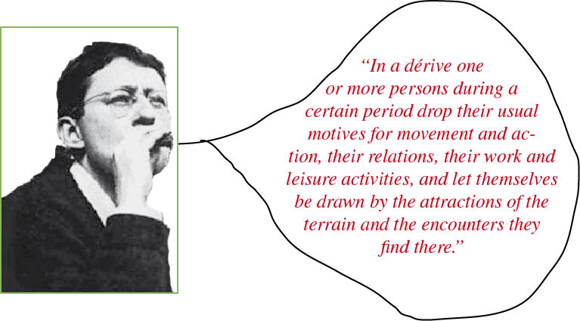
Rotational Inertia
Derivations- Part I

Slide 3
Quick review problem
A solid ball of mass 500 grams and radius 0.10 m is thrown at 28 m/s. As it travels through the air, it spins with an angular speed of 110 rad/second. What is its
translational kinetic energy?
rotational kinetic energy?
total kinetic energy?

Slide 4
College Board Standards
E. Circular motion and rotation
2. Torque and rotational statics
c) Students should develop a qualitative understanding of rotational inertia, so they can:
(1) Determine by inspection which of a set of symmetrical objects of equal mass has the greatest rotational inertia.
(2) Determine by what factor an object’s rotational inertia changes if all its dimensions are increased by the same factor.
d) Students should develop skill in computing rotational inertia so they can find the rotational inertia of:
(1) A collection of point masses lying in a plane about an axis perpendicular to the plane.
(2) A thin rod of uniform density, about an arbitrary axis perpendicular to the rod.
(3) A thin cylindrical shell about its axis, or an object that may be viewed as being made up of coaxial shells.
e) Students should be able to state and apply the parallel-axis theorem.

Slide 5
College Board Standards
E. Circular motion and rotation
2. Torque and rotational statics
c) Students should develop a qualitative understanding of rotational inertia, so they can:
(1) Determine by inspection which of a set of symmetrical objects of equal mass has the greatest rotational inertia.
(2) Determine by what factor an object’s rotational inertia changes if all its dimensions are increased by the same factor.
d) Students should develop skill in computing rotational inertia so they can find the rotational inertia of:
(1) A collection of point masses lying in a plane about an axis perpendicular to the plane.
(2) A thin rod of uniform density, about an arbitrary axis perpendicular to the rod.
(3) A thin cylindrical shell about its axis, or an object that may be viewed as being made up of coaxial shells.
e) Students should be able to state and apply the parallel-axis theorem.

Slide 6
Rotational Inertia Calculations
I = Σmr² (for a system of particles)
I = ∫ dm r² (for a solid object)
I = I_{cm} + m h² (parallel axis theorem)
I: rotational inertia about center of mass
m: mass of body
h: distance between axis in question and axis through center of mass

Slide 7
Practice Problem
Derive the rotational inertia of a long thin rod of length L and mass M about a point 1/3 from one end using integration.

Slide 8
Practice Problem
Derive the rotational inertia of a long thin rod of length L and mass M about a point 1/3 from one end using the parallel axis theorem and the rotational inertia of a rod about the center.

Slide 9
Practice Problem
Derive the rotational inertia of a flat disk of radius R rotating about the center. Use the rotational inertia of a ring as the starting point.

Slide 10
Try this one on your own!
Derive the rotational inertia of a solid sphere rotating about an axis through the center. Use the rotational inertia of a spherical shell as the starting point.

