Slide 1
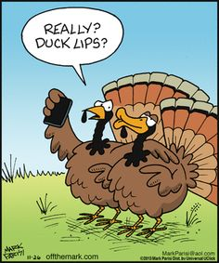
ANNOUNCEMENTS:
Tomorrow’s lesson will begin with a derivation quiz!
Lots of HW this unit- don’t get behind!
Ch 10 HW Quiz & HW due Tues 12/1
Ch 11 HW Quiz & HW due Thurs 12/10
Rotation Exam Tues 12/15

Slide 2
Rotational Inertia Problem Day

Slide 3
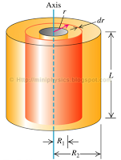
Solid Cylinder derivation:

Slide 4
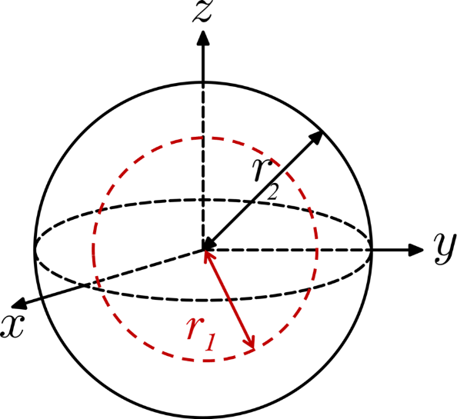
Practice Problem
Derive the rotational inertia of a solid sphere rotating about an axis through the center. Use the rotational inertia of a hollow sphere as the starting point.

Slide 5
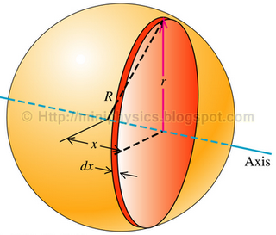
Practice Problem
Derive the rotational inertia of a solid sphere rotating about an axis through the center. Use the rotational inertia of a disc as the starting point.

