Slide 1
ANNOUNCEMENTS:
Tomorrow: Mechanics FR Due (go to Pickel)
FRIDAY: LR Circuit Derivation Quiz
4/26-27: Mechanics Mock
4/28-29: Magnetism Exam (Ch 30 HW due-4)
5/2: E&M MC Packet Due
5/3-5/5 E&M Mock AP
5/6: E&M FR Packet Due
5/9: AP and/or Final Exams (21 Days!)

Slide 2
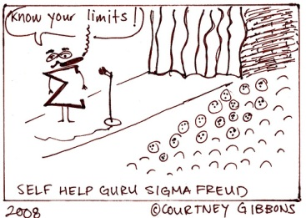
Self-Inductance

Slide 3
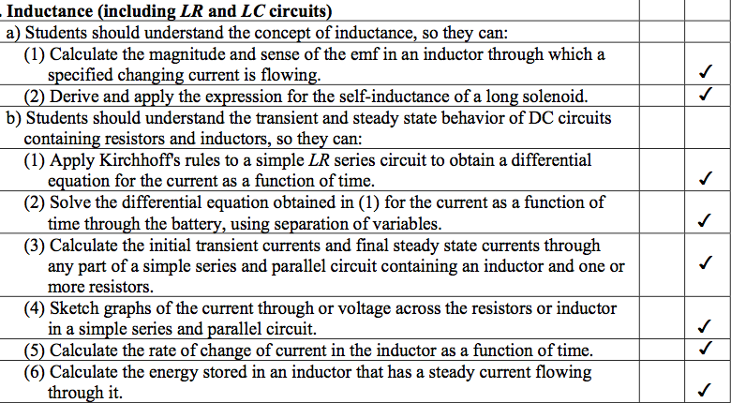
AP Course Objectives

Slide 4
Inductor
An inductor is a conducting coil.
An inductor in a circuit resists change in current with an induced potential.
An inductor stores energy in a magnetic field.
The “strength” of an inductor is determined by is “inductance”, represented by the letter L.
The unit of inductance is the Henry, H.

Slide 5
Self-Inductance
The inductance of an inductor is a measure of how much “back emf” it produces when the current through it’s coils is changing.
ε_{L} = -L di/dt
ε_{L:} potential across inductor
L: inductance in Henrys
i: current in amperes
t: time in seconds

Slide 6
Inductor, L
L
When switch is first closed, ε_{L} opposes emf of cell.
ε_{L}
i
ε

Slide 7
Inductor, L
L
When switch is opened, ε_{L} supports emf of cell.
ε_{L}
i
ε

Slide 8
RL Circuit – switch closed
L
ε_{L}
ε
R
V_{R}

Slide 9
RL Circuit – switch opened
L
R

Slide 10
Sample problem: A coil has an inductance of 3.00 mH and the current changes from 0.200 A to 1.5 A in a time of 0.200 s. Find the magnitude of the average induced emf in the coil during this time.

Slide 11
Sample problem: A 12.0 volt battery is connected in series with a 10.0 Ω resistor and a 2.00 H inductor. How long will it take the current to reach 50% of its final value?

