Slide 1
ANNOUNCEMENTS:
Ch 28-29 HW Quiz and HW due Friday
Mechanics Review MC due Monday
Mechanics Review FR due Monday 4/18
LR Circuit Derivation Quiz 4/22
Mechanics Mock AP 4/26-27
Magnetism Exam (+Ch 30 HW) 4/28-29
E&M Mock AP various days 5/3-5/5
AP EXAMS 5/9

Slide 2
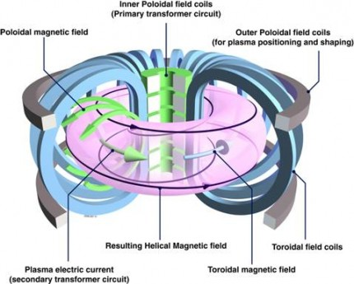
Ampere’s Law- Solenoids and Toroids

Slide 3
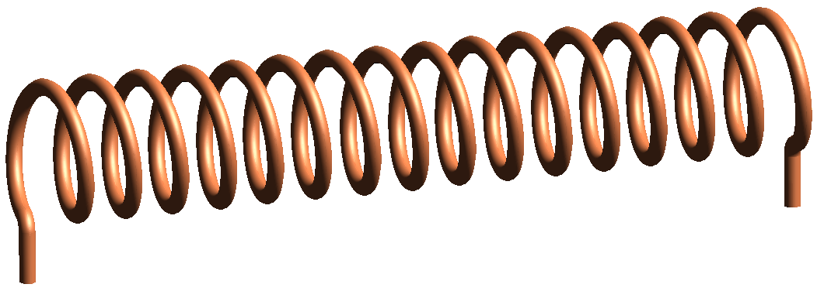
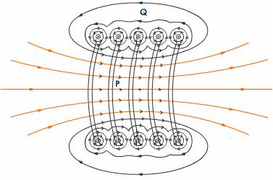
Solenoid
A long, tightly wound helical coil of wire:
The magnetic field is the vector sum of the fields produced by the individual turns.
Fields tend to cancel between adjacent turns
At points inside the solenoid and outside B is approximately parallel to the central axis.

Slide 4
Ampere’s Law for a Solenoid

Slide 5
Sample problem: A solenoid has length L= 1.23 m and an inner diameter d = 3.55 cm, and it carries a current I = 5.57 A. It consists of 5 close packed layers, each with 850 turns along length L. What is B at its center?

Slide 6
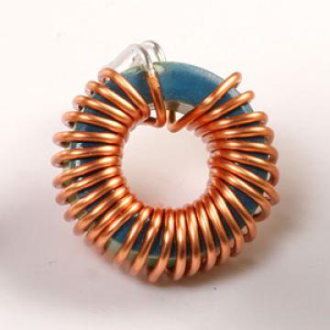
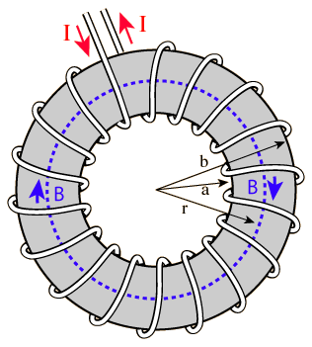
Toroid
A hollow solenoid that has been curved until its two ends meet.
From symmetry we can see that B forms concentric circles inside the ring.

Slide 7
Sample Problem: Use Ampere’s Law to derive the magnetic field at various spots around the Toroid.

Slide 8
A local perspective

