Slide 1
ANNOUNCEMENTS:
AP Registration- 2nd payment due today
Mechanics review begins 3/30
Biot-Savart Quiz 3/31
Ch 28-29 HW Quiz + HW due 4/8
Magnetism Exam (Ch 28-30) 4/28-29
AP EXAMS MON. 5/9.
Mechanics 12-1:30
E&M 2-3:30

Slide 2
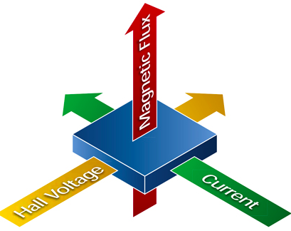
Hall Effect

Slide 3
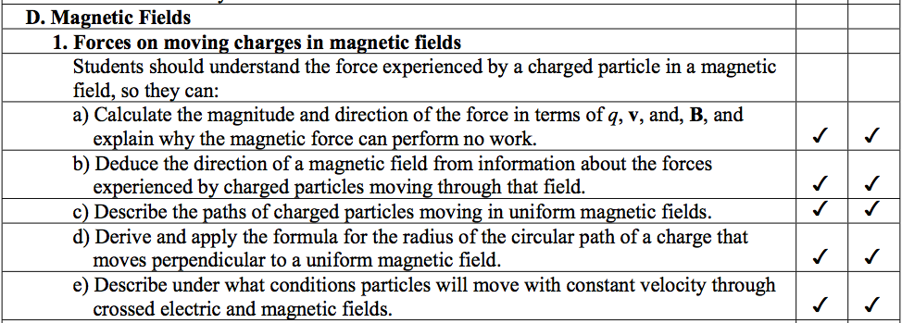
College Board Objectives

Slide 4
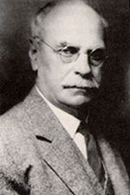
How do we know charge carriers in a wire are negative?
The “Hall Effect” helps us answer that question.
Edwin Herbert Hall (1855-1938)
Graduated from The Johns Hopkins University
Relates the interactions of charge carriers in current, magnetic fields, Lorentz forces, electric fields and forces.
Sound complicated? Let’s have a look.

Slide 5
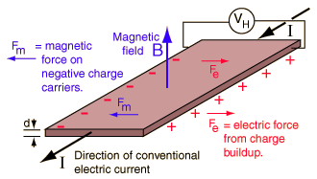
How do we know charge carriers in a wire are negative?
Potential across a wire is measured.
The position of high and low potential is determined.
The position of high and low potential indicates the sign of the moving charge.

Slide 6
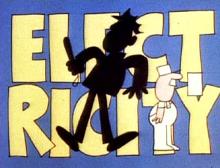
Electricity

Slide 7
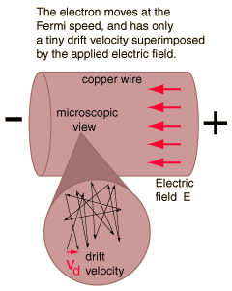
Common Misconception
The rate at which charge flows
Not necessarily a steady movement of a line of charge
Drift velocity!

Slide 8
Problem 1: From the setup below, determine the drift speed of the electrons. Determine additional measurements needed, assuming you know the magnitudes of the voltage (V) and magnetic field (B)?
V
B
A
i
B

Slide 9
Problem 2: A wire carries a current i through a magnetic field as shown. What is the sign of the charge carriers bearing the current if (a) S is at a higher potential than T and (b) T is at a higher potential than S?
V
B
S
i
T

