Slide 1
ANNOUNCEMENTS:
Tomorrow: THE MARTIAN!!!!!!!
Ch 7 HW Quiz and Ch 7 HW due Tuesday 10/20.
UTED
Thurs 10/22
Work time 10/19-21 lunches
Rockets! 10/26-10/30
Energy and Momentum EXAM 11/12

Slide 2
Work by Variable Forces
Objective: To calculate work done by a specified variable force

Slide 3
Work and Variable Forces
We’ve seen that for constant forces:
How would you modify this if the force varies with position?
Objective: To calculate work done by a specified variable force.

Slide 4
Work and variable force
How would I use the graph to determine the work performed by this force in moving an object from x_{a} to x_{b}?
Write, as completely as possible, a formula that will allow calculation of this work by analytical means.
F(x)
x_{a}
x_{b}
x
Objective: To calculate work done by a specified variable force.

Slide 5
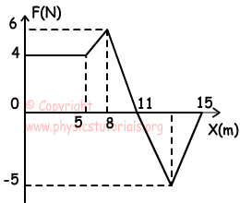
Problem: Determine the amount of work done by F on an object if it moves the object from x = 0 to x = 15 m.
Objective: To calculate work done by a specified variable force.

Slide 6
Problem: A force acting on a particle, F_{x} = (4x – x²)N, moves the particle from x = 1 to x = 2 along the x-axis. Find the work done on the particle by the force.
Objective: To calculate work done by a specified variable force.

Slide 7
Problem: Derive an expression for the work done by a spring as it is stretched from its equilibrium position
Objective: To calculate work done by a specified variable force.

